Slide 1
Broadcast with Tree Selection on An Overlay Network
Takeshi Kaneko and Kazuyuki Shudo

Slide 2
Problem
If a single node is broadcasting, a spanning tree can be used to achieve a small number of messages, but the length of the tree is an issue.
If multiple nodes are broadcasting, efficient topology differs per node, reducing efficiency.

Slide 3
Proposed Solution
Have each source node select an efficient tree when broadcasting
It is assumed that there is a finite number of spanning trees per graph
A source node selects tree T that minimizes height.

Slide 4
System
Each spanning tree is embedded in a generic overlay network managed by a peer sampling service.
Spanning trees are maintained along Plumtree protocol.
Each node has two types of neighbors: eager and lazy.
Eager neighbors are along tree edges, lazy are not.
Broadcasts are performed over a tree/forwarding to eager peers.
If a node gets a message from a non-eager peer, it will begin repairing.
Nodes will prune both themselves and the sender if they receive the same message from multiple neighbors.

Slide 5
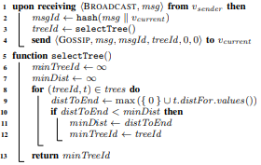
Broadcast with Tree Selection
When a node receives a broadcast request, it selects a tree to send on.
To select the tree
It gets the max distance of all nodes from the source node, for each tree.
It then returns the tree with the smallest max distance’s ID

Slide 6
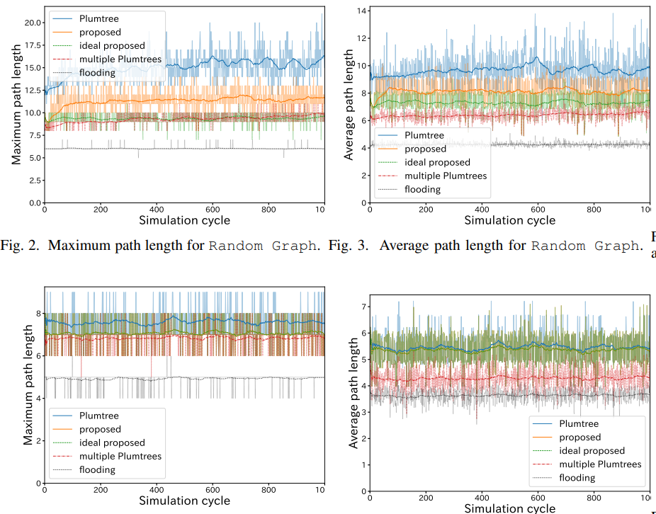
Results
Path reduction while maintaining small number of messages.
Greater path reduction for random graphs than Barabasi-Albert Model graphs.
Maximum path length reduced by 28% compared to Plumtree on random, 7% for BA model.

