Slide 1
An Introduction to the Kalman Filter
Presenter: Yufan Liu
yliu33@kent.edu
November 17th, 2011

Slide 2
Outline
Background
Definition
Applications
Processes
Example
Conclusion

Slide 3
Low and high pass filters
Low pass filter allows passing low frequency signals. It can be used to filter out the gravity.
High pass filter allows high frequency signals to pass.
Band pass filter is a combination of these two.
They are working on frequency domain.

Slide 4
Definition of Kalman filter
It is an optimal (linear) estimator or optimal recursive data processing algorithm.
Belongs to the state space model(time domain) compared to frequency domain
Components: system's dynamics model, control inputs, and recursive measurements(include noise)
Parameters include indirect, inaccurate and uncertain observations.

Slide 5
Typical Kalman filter application

Slide 6
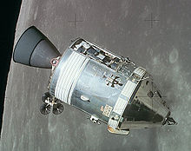
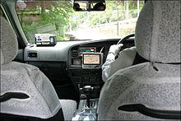
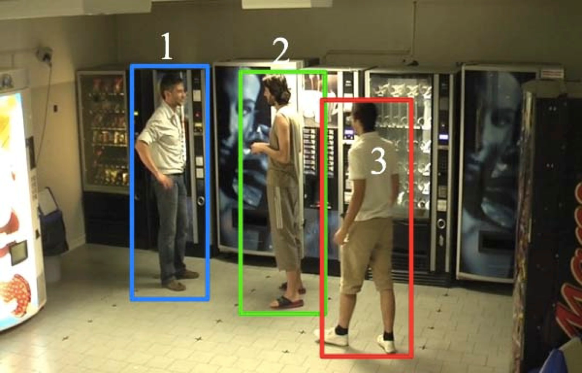
Applications
http://en.wikipedia.org/wiki/Apollo_program
http://en.wikipedia.org/wiki/Gps
http://www.lorisbazzani.info/research-2/

Slide 7
Hidden Markov Model
Markov Property :The next n+1 depends on n but not the entire past(1…n-1)
The state is not clearly visible, but the output is visible
The states give us information on the system.
The task is to derive the maximum likelihood of the parameters

Slide 8
HMM example
http://en.wikipedia.org/wiki/Hidden_Markov_model

Slide 9
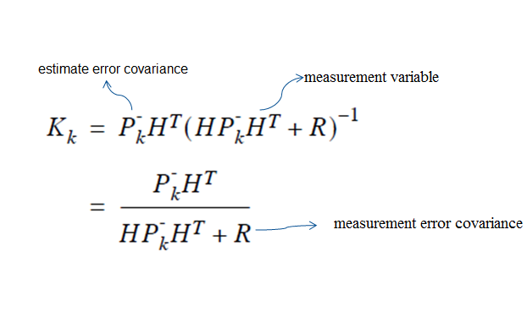
Major equation

Slide 10
Step 1: Build a model
Any x_{k} is a linear combination of its previous value plus a control signal u_{k} and a process noise.
The entities A, B and H are in general matrices related to the states. In many cases, we can assume they are numeric value and constant.
W_{k-1} is the process noise and v_{k} is the measurement noise, both are considered to be Gaussian.

Slide 11
Step 2: Start process

Slide 12
Step 3: Iterate

Slide 13
A simple example
Estimate a random constant:” voltage” reading from a source.
It has a constant value of aV (volts), so there is no control signal uk. Standard deviation of the measurement noise is 0.1 V.
It is a 1 dimensional signal problem: A and H are constant 1.
Assume the error covariance P0 is initially 1 and initial state X0 is 0.

Slide 14
A simple example – Part 1
Time | 1 | 2 | 3 | 4 | 5 | 6 | 7 | 8 | 9 | 10
Value | 0.39 | 0.50 | 0.48 | 0.29 | 0.25 | 0.32 | 0.34 | 0.48 | 0.41 | 0.45

Slide 15
A simple example – Part 2

Slide 16
A simple example – Part 3

Slide 17
Result of the example

Slide 18
The Extended Kalman filter
In simple cases, such as the linear dynamical system just, exact inference is tractable; however, in general, exact inference is infeasible, and approximate methods must be used, such as the extended Kalman filter.
Unlike its linear counterpart, the extended Kalman filter in general is not an optimal estimator

Slide 19
Properties and conclusion
If all noise is Gaussian, the Kalman filter minimizes the mean square error of the estimated parameters
Convenient for online real time processing.
Easy to formulate and implement given a basic understanding.
To enable the convergence in fewer steps:
Model the system more elegantly
Estimate the noise more precisely

Slide 20
Reference
Lindsay Kleeman, Understanding and Applying Kalman Filtering, Department of Electrical and Computer Systems Engineering, Monash University, Clayton
Peter Maybeck, Stochastic Models, Estimation, and Control, Volume 1
Greg Welch, Gary Bishop, "An Introduction to the Kalman Filter", University of North Carolina at Chapel Hill Department of Computer Science, 2001
Thank you

