Slide 1
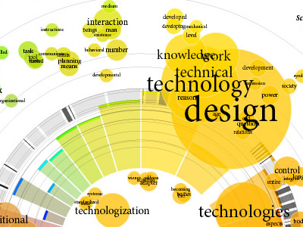
STREAMIT: Dynamic Visualization and Interactive Exploration of Text Streams
IEEE Pacific Visualization Symposium, March, 2011
Jamal Alsakran Kent State University, Ohio
Ye Zhao Kent State University, Ohio
Yang Chen University of North Carolina -Charlotte
Jing Yang University of North Carolina –Charlotte DongningLuo University of North Carolina -Charlotte
Presented by :
Peter Correia
Kent State University
pcorreia@kent.edu

Slide 2
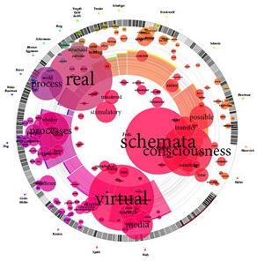
Outline
Introduction
- Need
- Challenges
SREAMIT System
-System Overview
-Force-Based Dynamic System
-Dynamic Keyword Importance
-Visualization And Interaction
Case Studies
Performance Optimization
Conclusion
References
http://www.visualcomplexity.com/vc/project_details.cfm?id=303&index=40&domain=Knowledge%20Networks

Slide 3
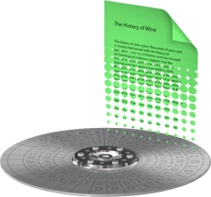
Need
Explore huge data set
Adapt data of dynamic and increasing nature
Need for efficient processing and analysis
Topics not known in advance
???

Slide 4
Challenges
Temporal evolution
Real time processing required
No priori knowledge of data
Providing user interaction for adjusting or changing

Slide 5
Outline
Introduction
-Need
-Challenges
SREAMIT System
- System Overview
- Force-Based Dynamic System
- Dynamic Keyword Importance
- Visualization And Interaction
Case Studies
Performance Optimization
Conclusion
References

Slide 6
SREAMIT System
Continual evolvement
Dynamic processing
Interactive exploration
Scalable optimization
Dynamic visualization and animation
Interaction

Slide 7
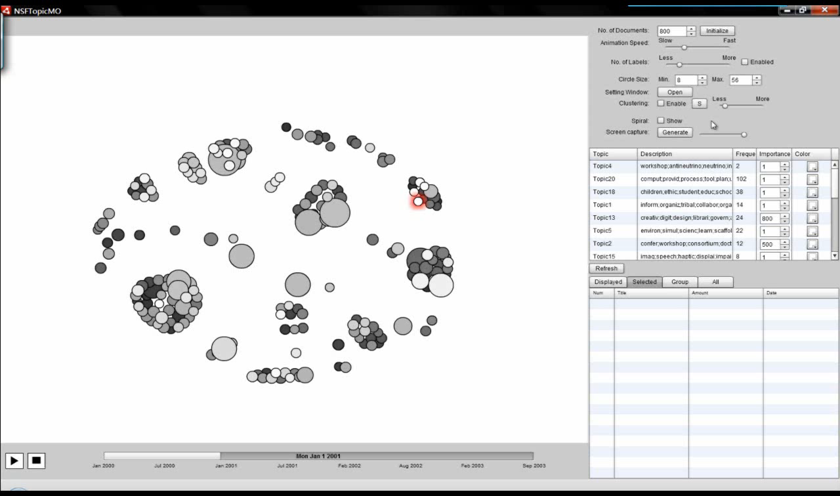
SREAMIT System

Slide 8
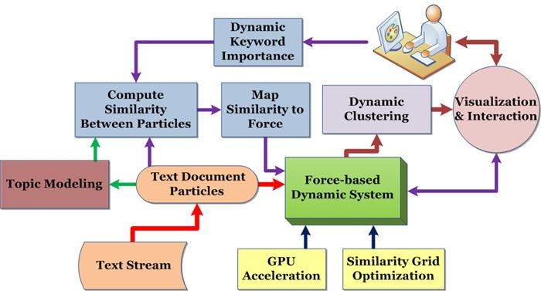
System Overview

Slide 9
Force-Based Dynamic System
Potential energy between pairs of document particles:
Ideal distance computed from document similarity :
Cosine similarity ->
Similar documents -> smaller ideal distance -> move documents closer to form clusters

Slide 10
Dynamic Keyword Importance
Importance freely modified by users at any time:
- According to interest/preference
- According to discovered knowledge from prior period
-Tool to manipulate layout and analyze data
http://1.bp.blogspot.com/-h3A-2loNOlc/TaVLolzEdvI/AAAAAAAAAO0/QZ_vPq9PeJw/s1600/Ignorance_vs_Knowledge_by_casperium.jpg

Slide 11
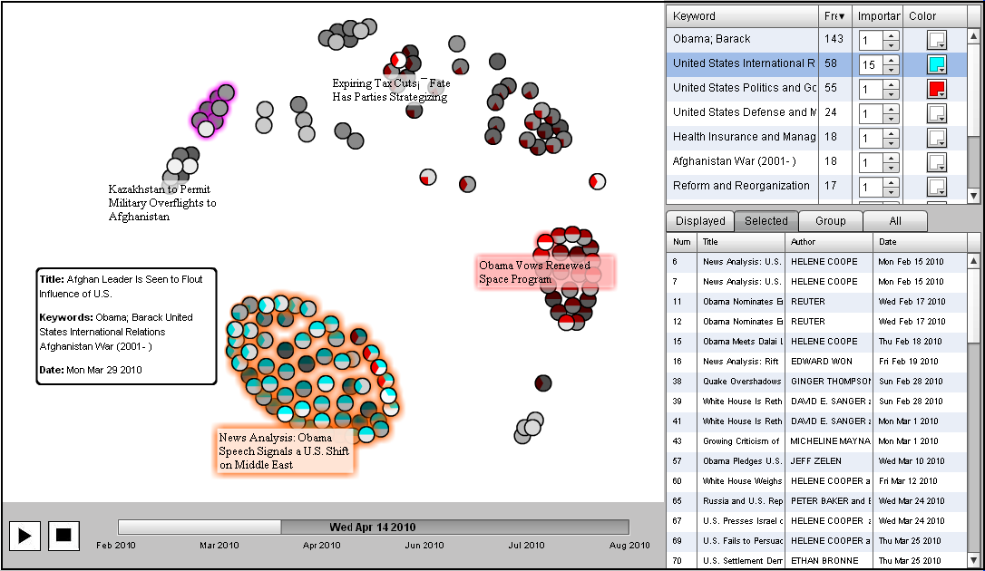
Visualization and Interaction

Slide 12
User Interaction
Adjusting Keyword Importance
Browsing and Tracking Keywords
Selection
Integrated shoebox for details

Slide 13
Outline
Introduction
-Need
-Challenges
SREAMIT System
-System Overview
-Force-Based Dynamic System
-Dynamic Keyword Importance
-Visualization And Interaction
Case Studies
Performance Optimization
Conclusion
References

Slide 14
Case Study: New York Times News
Total article number: 230
Time period Jul. 19 and Sep. 18, 2010
About Barack Obama
Articles continuously injected, new keywords added to the keyword table, and their frequencies are updated on-the-fly
Keyword importance automatically assigned

Slide 15
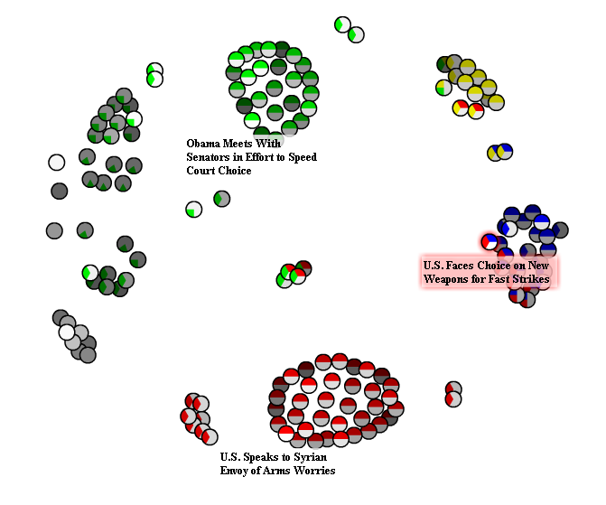
Case Study: New York Times News
136 news articles High frequency keywords:“Politics and Government”, “International Relations”, “Terrorism”

Slide 16
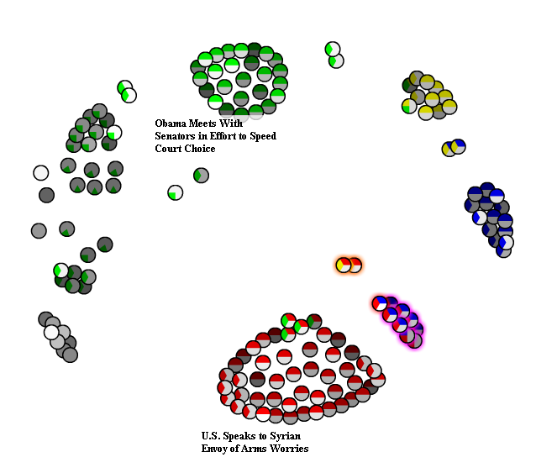
Case Study: New York Times News
Increase the importance of “International Relations”.
Highlight the group with “Afghanistan War” in pink halo (2)“Terrorism” in orange halo (3)

Slide 17
Outline
Introduction
-Need
-Challenges
SREAMIT System
-System Overview
-Force-Based Dynamic System
-Dynamic Keyword Importance
-Visualization And Interaction
Case Studies
Performance Optimization
Conclusion
References

Slide 18
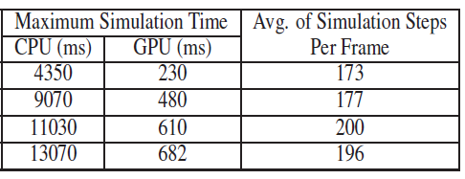
Performance Optimization

Slide 19
Outline
Introduction
-Need
-Challenges
SREAMIT System
-System Overview
-Force-Based Dynamic System
-Dynamic Keyword Importance
-Visualization And Interaction
Case Studies
Performance Optimization
Conclusion
References

Slide 20
Conclusion
STREAMIT: An efficient visual exploration system for live text streams
-Dynamic physical system
-Keyword manipulation with importance
-Visual tools

Slide 21
Outline
Introduction
-Need
-Challenges
SREAMIT System
-System Overview
-Force-Based Dynamic System
-Dynamic Keyword Importance
-Visualization And Interaction
Case Studies
Performance Optimization
Conclusion
References

Slide 22
References
[1] C. Albrecht-Buehler, B.Watson, and D. Shamma. Visualizing live text
streams using motion and temporal pooling. IEEE Computer Graphics
and Applications, 25(3):52–59, June 2005.
[2] K. Andrews, W. Kienreich, V. Sabol, J. Becker, G. Droschl, F. Kappe,
M. Granitzer, P. Auer, and K. Tochtermann. The infosky visual explorer:
Exploiting hierarchical structure and document similarities.
Information Visualization, 1(3):166–181, Dec. 2002.
[3] U. Brandes and S. Corman. Visual unrolling of network evolution and
the analysis of dynamic discourse. Information Visualization, 2(1):40–
50, 2003.
[4] M. Chalmers. A linear iteration time layout algorithm for visualising
high-dimensional data. In Proceedings of the 7th conference on
Visualization ’96, 1996.
[5] Y. Chen, L.Wang,M. Dong, and J. Hua. Exemplar-based visualization
of large document corpus (infovis2009-1115). IEEE Transactions on
Visualization and Computer Graphics, 15(6):1161–1168, 2009.
[6] Y. Frishman and A. Tal. Online dynamic graph drawing. IEEE
Transactions on Visualization and Computer Graphics, 14(4):727–
740, Aug. 2007.
[7] T. Fruchterman and E. Reingold. Graph drawing by force-directed
placement. Software - Practice and Experience, 21(11):1129–1164,
Nov. 1991.
[8] M. Ghoniem, D. Luo, J. Yang, andW. Ribarsky. Newslab: Exploratory
broadcast news video analysis. In Proceedings of the 2007 IEEE Symposium
on Visual Analytics Science and Technology, pages 123–130,
2007.
[9] J. Han and M. Kamber. Data mining: concepts and techniques, 2nd
Edition. Morgan Kaufmann, San Francisco, CA, USA, 2006.
[10] S. Havre, P. Whitney, and L. Nowell. Themeriver: Visualizing thematic
changes in large document collections. IEEE Transactions on
Visualization and Computer Graphics, 8:9–20, 2002.
[11] E. G. Hetzler, V. L. Crow, D. A. Payne, and A. E. Turner. Turning
the bucket of text into a pipe. In Proceedings of IEEE Symposium
on Information Visualization, page 12, Washington, DC, USA, 2005.
IEEE Computer Society.
12] Y. Ishikawa and M. Hasegawa. T-scroll: Visualizing trends in a timeseries
of documents for interactive user exploration. Lecture Notes in
Computer Science, 4675:235–246, Nov. 2007.
[13] J. Leskovec, L. Backstrom, and J. Kleinberg. Meme-tracking and the dynamics of the news cycle. In Proceedings of the 15th ACMSIGKDD international conference on Knowledge discovery and data mining, pages 497–506, 2009.
[14] S. Liu, M. X. Zhou, S. Pan, W. Qian, W. Cai, and X. Lian. Interactive, topic-based visual text summarization and analysis. In Proceeding of the 18th ACM conference on Information and knowledge management, pages 543–552, 2009.
[15] D. Luo, J. Yang, M. Krstajic, J. Fan,W. Ribarsky, and D. Keim. Eventriver: An event-based visual analytics approach to exploring large text collections with a temporal focus. In IEEE Transactions on Visualization and Computer Graphics, To appear.
[16] H. Luo, J. Fan, Y. Gao, W. Ribarsky, and S. Satoh. Large-scale news video retrieval via visualization. In in ACM Multimedia, pages 783– 784, 2006.
[17] A. Morrison, G. Ross, and M. Chalmers. A hybrid layout algorithm for sub-quadratic multidimensional scaling. In Proc. IEEE Symposium on Information Visualization, pages 152–158, 2002.
[18] L. Nyland, M. Harris, and J. Prins. Fast n-body simulation with cuda.
In GPU Gems 3.
[19] F. Paulovich and R. Minghim. Hipp: A novel hierarchical point placement strategy and its application to the exploration of document collections. IEEE Transaction on Visualization and Computer Graphics, 16(8):1229–1236, Nov. 2008.
[20] D. C. Rapaport. The Art of Molecular Dynamics Simulation. Cambridge University Press, New York, NY, USA, 1996.
[21] G. Salton and C. Buckley. Term-weighting approaches in automatic text retrieval. Information Processing and Management, 24(5):513– 523, 1988.
[22] F. B. Viegas, S. Golder, and S. Donath. Visualizing email content: portraying relationships from conversational histories. In Proceedings of the SIGCHI conference on Human Factors in computing systems, pages 543–552, 2006.
[23] J. A.Wise, J. J. Thomas, K. Pennock, D. Lantrip, M. Pottier, A. Schur, and V. Crow. Visualizing the non-visual: spatial analysis and interaction with information for text documents. pages 442–450, 1999.
[24] P. C. Wong, H. Foote, D. Adams, W. Cowley, and J. Thomas. Dynamic visualization of transient data streams. IEEE Symposium on Information Visualization, 0:13, 2003.
[25] J. Yang, D. Luo, and Y. Liu. Newdle: Interactive visual exploration of large online news collections. IEEE Computer Graphics and Applications, 30:32–41, 2010.

Slide 23
Acknowledgment
National Science Foundation IIS-0915528, IIS-0916131 and NSFDACS10P1309.

