Slide 1
Revealing Structure within Clustered Parallel Coordinates Displays
Jimmy Johansson, Patric Ljung, Mikael Jern, Matthew Cooper
NVIS- Norrkoping Visualization and Interaction Studio, Linkoping University, Sweden
Presented by Xinyu Chang Kent State University
xchang@kent.edu
Notes:
The title of my presentation is revealing structure within clustered parallel coordinates displays

Slide 2
1.Introduction
2.Related work
3.High-precision textures
4.Transfer function
5.Enhancing outliers
6.Feature animation
7.Conclusions and future work
Notes:
In the catalog, you can have a overview of my presentation, First of all I will introduce you the general definition of Parallel Coordinates , and after that is related work before , what problem we were facing, and then four ways of improve the quality data revealing. At last is the conclusions and future work.

Slide 3
1.Introduction
Notes:
Introduction!

Slide 4
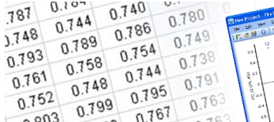
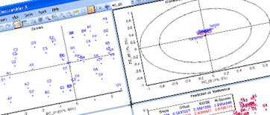
Introduction
Multivariate data
Data collected on several variables for each sampling unit.
Notes:
Multivariate data is data collected on several variables for each sampling unit.
Today, multivariate data are common and as soon as we collect data or perform a simulation, we are faced with the difficulties of analyzing and understanding complex data structures. They have limitations in how many data items can be simultaneously perceived and interactively investigated.

Slide 5
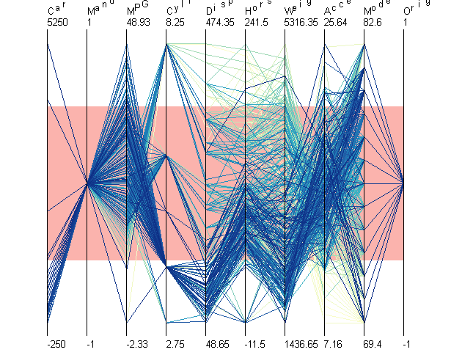
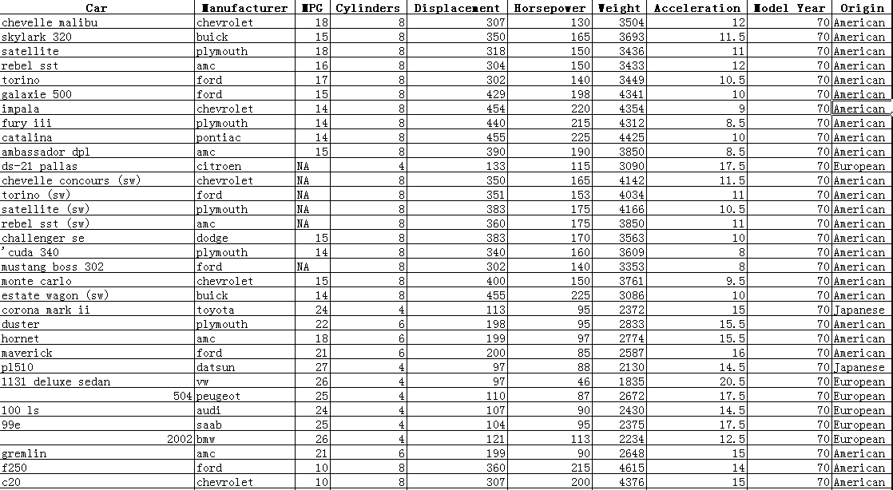
Introduction
Parallel coordinates
A example of revealing multivariate data with parallel coordinates technique
Notes:
This is a example of revealing multivariate data with parallel coordinates technique , actually this is a homework of a grad student in our department. Every section between these vertical axis stands for one property of a data item in the left side. Parallel coordinates is an excellent tool for visualizing this type of data but has its limitations of how to visualize a large number of data items without hiding the inherent structure they constitute.

Slide 6
Introduction
Cluster
All relate to grouping or segmenting a collection of objects into subsets or “clusters,” such that those within each cluster are more closely related to one another than objects assigned to deferent clusters.
A clustering algorithm aims at grouping data items so that items in a cluster are as similar as possible and as different from data items in the other clusters as possible. Clusters can be expressed in different ways.
Notes:
Read it. A cluster in the group of related data items, we always want data in one cluster as same as possible and data out side the cluster as different as possible, and that is what a clustering algorithm does.

Slide 7
2.Related work
Notes:
Related work! I will going through this really quick.

Slide 8
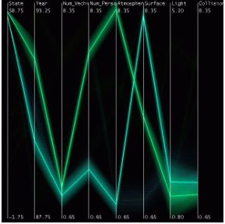
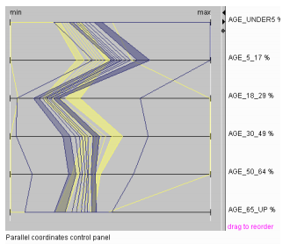
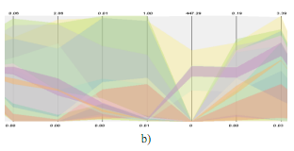
Related work
Y.H.Fua, M.O. Ward,and E.A.Rundensteiner. 1999.
G. Andrienko and N. Andrienko.2004
M. No votny. 2004.
Notes:
The first picture which reveals the true size of each cluster but presents limited information about the structure within each cluster.
The second picture as well as the first one has divided the data item into several dimentions. But A limitation of both they can not show the relationship between each dimension.
And the third picture provide a good overview of the global structure of the data but do not completely succeed in revealing all relevant aspects of the structure within the clusters.

Slide 9
3. High-precision textures
Notes:
Let’s get to the main course of my presentation. High-precision textures, This section describes how to generate a high-precision texture that can be used to reveal different types of cluster information.

Slide 10
High-precision textures
Framebuffer limitation
When dealing with very large data sets, the number of lines needed to be rendered may cause limitations in interactivity.
When the intensity level displayed by the parallel coordinates more than the number framebuffer supports, this information can not be revealed using additive blending.
Solution
Divide the data into subset equals to the capacity of the framebuffer, after the subset get rendered, accumulate them in a higher precision buffer.
subset
FRAMEBUFFER
RENDERED
DATA
RENDERED
RENDERED
Higher precision buffer

Slide 11
High-precision textures
Intensity range and transparency
This value, ρ ,is used to normalize the intensity range ensuring that all intensity information is retained.
ρ_{i} Equals to the value of overlapping lines.
ρ _{global} is the largest of ρ_{i} .
If we normalize the resulting image using ρ _{global} ,clusters with a small maximum intersecting value will be more transparent. Normalizing each cluster individually using ρ_{i} ,each cluster’s maximum intersecting value will be perceived as equally dense. Both approaches are, in a sense correct, only highlighting different aspects.
Notes:
Please look at the picture on right, because the difference in number of lines overlapping will affect the value of transparency, the structure of a cluster has became more obvious. The mechanic is this…
When use the global value, the cluster with lower intensity will be more transparent. The both way of implementation are right, beacause the user could chose one according to their needs.

Slide 12
4.Transfer function

Slide 13
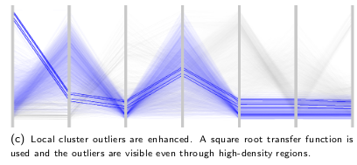
Transfer function
The concept of using a transfer function(TF)in conjunction with parallel coordinates to allow for a more powerful and customized analysis process. A TF deﬁned as
enables the user to easily investigate different aspects of the data by mapping a data value, s ,to an opacity value, α .Both pre-deﬁned as well as user-deﬁned TFs may be used.

Slide 14
Transfer function

Slide 15
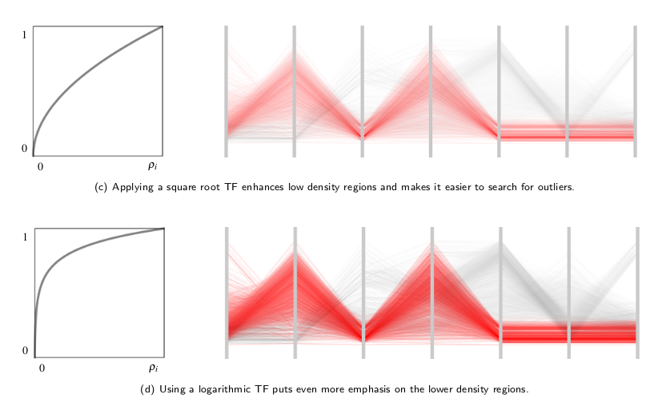
Transfer function

Slide 16
5.Enhancing outliers

Slide 17
Enhancing outliers
Outlier a data item that differs from the main trend in a particular cluster.
In order to gain additional insight into a data set, outliers must be investigated.
The enhanced outliers are displayed using a separate texture, thus they can be easily switched on or off
We use a method based on the interquartile range to deﬁne if a data item is an outlier or not.

Slide 18
Enhancing outliers
Way of define outlier: interquartile range
For each cluster, i ,and dimension, j ,the interquartile range, ,is deﬁned as the difference between upper and lower quartiles, - ,where is the 25th percentile and is the 75th percentile. The data items that belong to cluster i , are determined to be outliers if they fall β above or below This is done for each dimension, j ,independently. The value of β may be interactively changed, but one commonly used rule when searching for outliers is to use β = 1 . 5. Larger values of β can be used to identify more extreme outliers.
Outlier
Cluster
Outlier
Notes:
The value of Qiqr ij means the item in the cluster between q1 the top 25th percentile and q3 75th percentile.
Which indicates that in the Qiqr ij is the data item in the cluster and others are the outliers
When modify the value of β we could justify the width of outlier section, to get more or less exetreme outliers.

Slide 19
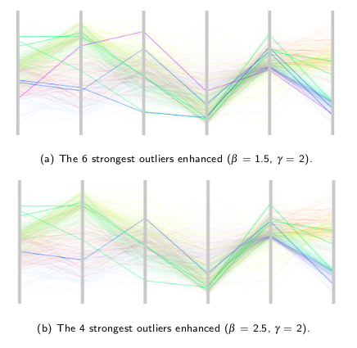
Enhancing outliers
Notes:
This is a example of revealing outliers, The strong lines is the outliers being enhanced with its separate texture. These two pictures show when Changing the value of B, more extreme case of outlier will be shown, and the parameter γ , may be used to specify in how many dimensions a data item needs to be classiﬁed

Slide 20
6.Feature animation

Slide 21
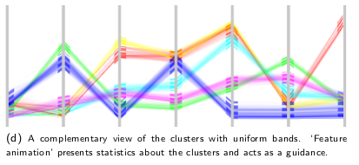
Feature animation
‘Feature animation' as an intuitive way of visualizing statistical properties of the clusters. Both the variance and skewness of a cluster may be used as a guidance as to where to start the analysis
Uniform band, a cluster displayed at the centroid, rather than presented in its true size, will not take up as much vertical space and can therefore be used to get a good overview of the data.
Notes:
The featured animation is more effective when it is displayed in the way of uniform band.

Slide 22
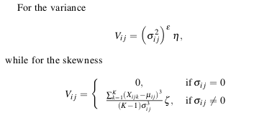
Feature animation
By animating the variance the user can quickly examine each cluster to see if the cluster is tight or loose.
By animating the skewness the amount of asymmetry in the distribution is measured.
µ_{ij} is the mean of the X_{ijk}
σ _{ij} is the standard deviation
V_{ij} is speed in which the vertical texture coordinates should be translated
η and ζ are global constants used to control the speed of the animation.
Notes:
N ETA
KEDOU SIGMA
U MIU
GOU ZETA

Slide 23
7.Conclusions and future work

Slide 24
Thank you

