Slide 1
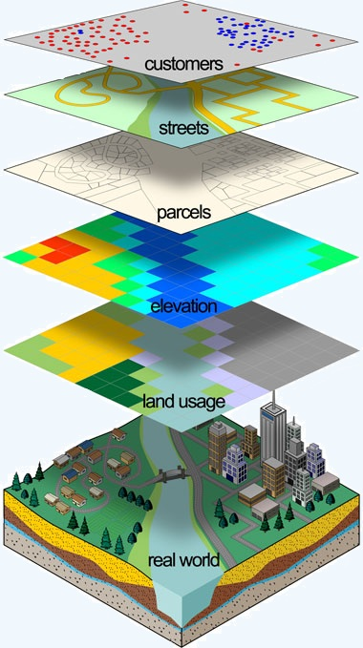
Quality Control Measurements for GIS data
Presented by Amal Babour
Kent State University
11-28-2011
Email: ababour@kent.edu

Slide 2
Outline
Introduction
What is GIS?
GIS components
Problem statement
Complexity in GIS data creation
GIS quality standardization
What is quality?
Quality parameters
Metadata
Conclusion
References
http://www.grafenwoehr.army.mil/usag_dpw/master_planning/mp_installationmaps.asp

Slide 3
Outline
Introduction
What is GIS?
GIS components
Problem statement
Complexity in GIS data creation
GIS quality standardization
What is quality?
Quality parameters
Metadata
Conclusion
References
http://www.grafenwoehr.army.mil/usag_dpw/master_planning/mp_installationmaps.asp

Slide 4
Introduction
A Geographic Information System (GIS) is a system for capturing, storing, querying, analyzing, managing data and associated attributes which are spatially referenced to the earth.
GIS components:
http://gislinkup.com/GeneralInfo/WhatisGIS.html

Slide 5
Outline
Introduction
What is GIS?
GIS components
Problem statement
Complexity in GIS data creation
GIS quality standardization
What is quality?
Quality parameters
Metadata
Conclusion
References
http://www.grafenwoehr.army.mil/usag_dpw/master_planning/mp_installationmaps.asp

Slide 6
Problem statement
GIS data have different origins:
Undetermined the global accuracy
Different users expect the data provided to them fits for their purpose :
Wrong results
Lose time and money

Slide 7
Outline
Introduction
What is GIS?
GIS components
Problem statement
Complexity in GIS data creation
GIS quality standardization
What is quality?
Quality parameters
Metadata
Conclusion
References
http://www.grafenwoehr.army.mil/usag_dpw/master_planning/mp_installationmaps.asp

Slide 8
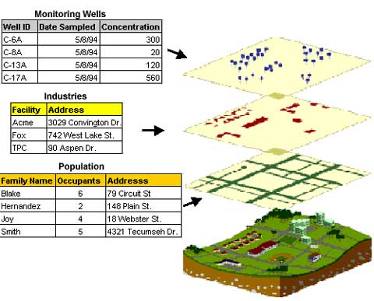
Complexity in GIS data creation
The main requirement for the data source is the locations of the variables
Necessity of Analysis
Cost
Accuracy
Scalability Issues
Standards/Formats
http://www.epa.gov/region5fields/htm/methods/gis/

Slide 9
Outline
Introduction
What is GIS?
GIS components
Problem statement
Complexity in GIS data creation
GIS quality standardization
What is quality?
Quality parameters
Metadata
Conclusion
References
http://www.grafenwoehr.army.mil/usag_dpw/master_planning/mp_installationmaps.asp

Slide 10
GIS quality standardization
4
1
2
3
5
1- http://www.continuityforum.org/content/news/161445/iso-22301-business-continuity-standard-moves-forward
2- http://www.directionsmag.com/companies/open-geospatial-consortium-ogc/93568
3- http://its-standards.info/
4- http://www.cgdi.us/
5- http://mcmcweb.er.usgs.gov/sdts/

Slide 11
GIS quality standardization (Cont.)
Quality is the totality of characteristics of an entity that bears its ability to satisfy stated and implied needs ‘1’.
Term “fit for use”
Quality Parameters:
Accuracy:
Positional accuracy
Distance Error =
Thematic accuracy
Temporal accuracy
2
1- (ISO 8402, 1994).
2- http://www.nanophase.com/quality/qualitysystems.aspx

Slide 12
GIS quality standardization (Cont.)
Quality Parameters (Cont.):
Resolution
Consistency
Completeness
Metadata: is a text document that describes
who, what, when, where, why and how
questions about the data.

Slide 13
Outline
Introduction
What is GIS?
GIS components
Problem statement
Complexity in GIS data creation
GIS quality standardization
What is quality?
Quality parameters
Metadata
Conclusion
References
http://www.grafenwoehr.army.mil/usag_dpw/master_planning/mp_installationmaps.asp

Slide 14
Conclusion
Data creators should have documented rules and guidelines when creating and updating data layers to eliminate any future questions about the data.
Quality evaluation needs to include users
applications.
The use of quality parameters is
theatrical until now.

Slide 15
Outline
Introduction
What is GIS?
GIS components
Problem statement
Complexity in GIS data creation
GIS quality standardization
What is quality?
Quality parameters
Metadata
Conclusion
References
http://www.grafenwoehr.army.mil/usag_dpw/master_planning/mp_installationmaps.asp

Slide 16
References
[1] Caprioli, M., Scognamiglio, A., Strisciuglio, G. and Tarantino, E. RULES AND STANDARDS FOR SPATIAL DATA QUALITY IN GIS ENVIRONMENTS . In Proceedings of the 21st International Cartographic Conference (ICC) (Durban, South Africa, 10 . 16 August 2003)
[2] Bernard Kumi-Boateng, Issaka Yakubu. Assessing the Quality of Spatial Data. European Journal of Scientific Research. ISSN 1450-216X Vol.43 No.4 (2010), pp.507-515
Thank you

