Slide 1
Facade Design Pattern
Simplifying Interface

Slide 2
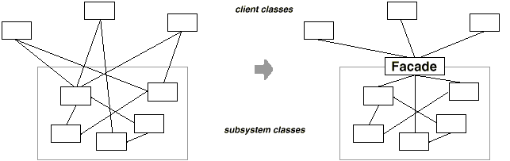
Facade
façade: object that provides
single simplified interface to
more general facilities
of a subsystem
motivation: fixed, potentially
complex classes, whose
interface cannot be changed
  legacy, used elsewhere, too complicated for clients
participants
  facade – knowns which subsystem classes are responsible for request, delegates requests to appropriate subsystem objects
  subsystem classes – implement functionality, are not aware of facade
promotes loose coupling between clients and subsystem
structural pattern

Slide 3
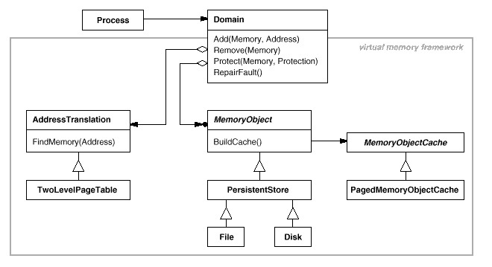
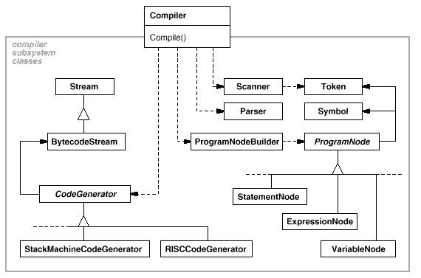
Façade Examples

Slide 4
Relationships to Other Patterns
adapter – wraps a single class
mediator – has more complex communication between (colleague) classes
façade is often singleton

