Slide 1
Composite Design Pattern
when collection is same as individual

Slide 2
Composite
motivation: graphics editor allows figures out of primitive items (lines, circles, points) then more complex figures out of simpler ones
  i.e. there is a hierarchy of figures
  it would be useful to treat subfigures and primitives uniformly
composite pattern – abstract class that represents both primitives and their containers
  allows clients to treat them uniformly
  encodes traversal of composition hierarchy
participants
  component – abstract uniform interface class for both collections and primitives items
  leaf - concrete primitive class
  composite – collection that possibly consists of leaves or other composites, implements interface and access (traversal) to children/parents
frequently used with Visitor Pattern where Composite implements traversal while Visitor implements processing of individual elements

Slide 3
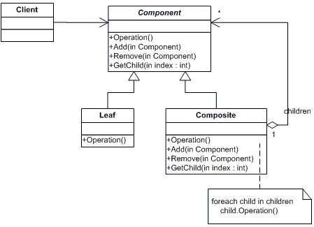
Composite UML Diagram
+Operation()
- children: set<Component>

Slide 4
Composite Review
what is the purpose for Composite Design Pattern?
what are component? leaf? composite?
what is composition hierarchy and how Composite Design Pattern allows to navigate it?
why and how it is used with Visitor Design Pattern?

