Slide 1
Command Design Pattern
when order needs to be given

Slide 2
Why Command and Where to Use
when need to issue request (command) on object from place that does not know about the action or the object (receiver) of the request
example:
GUI toolkit may have buttons/menus but does not know about business logic
Command Design Pattern allows to make request to receiver by turning request itself into an object – command
use if you need to
specify, keep, queue, execute requests at different time – command encapsulates request
support undo and command history
support logging/rollback/recovery – log commands
support transaction processing systems (ticket booking, banking …)

Slide 3
Command Participants
command – declares an interface for executing the operation, declares execute()
concrete command – implements execute(), acts on receiver
client – creates the concrete command object and sets up its receiver
receiver – object on which operations (commands) are performed
invoker - asks to execute the command

Slide 4
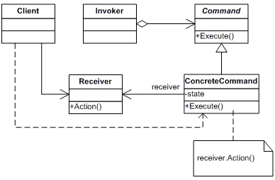
Command UML Diagram
+Execute()

Slide 5
Command Review
what is the motivation for Command Design Pattern? What are the applications where Command is useful?
what are abstract command? concrete command? client? receiver? invoker?
what is execute() unexecute() and why they are overridden?

