Slide 1
Strategy Design Pattern
changing algorithms

Slide 2
Strategy
many related classes differ only by their behavior, behavior may need to be changed at run-time, or behavior uses data (such as keys/passwords) to be hidden from clients
Strategy Pattern – encapsulate behavior into a class
  strategy – behavior (algorithm) to be encapsulated
    abstract – interface to algorithm
    concrete – implementation of the algorithm
  context - provides access for clients to algorithm, for algorithm to data
  delegates strategy execution to strategy
can have two communication methods
  push – context provides all data to strategy
  pull – strategy keeps track of context and gets data from it
eliminates complex subclass hierarchy for behaviors
eliminated if/else behavior selection in the code
behavioral pattern

Slide 3
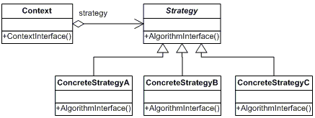
Strategy UML Diagram
(Push Method)
+AlgoirthmInterface()

Slide 4
Relationship to Other Patterns
Strategy looks similar to Bridge however
  Bridge is used to separate interface and implementation hierarchy
  Strategy provide replaceable algorithm

