Slide 1
Chandy Misra Haas Deadlock Detection Algorithm
By Purva Gawde
For Advanced Operating Systems
Instructor: Mikhail Nesterenko

Slide 2
Overview
Introduction
Objective
Experimental setup
Results
Conclusion
Future work
References

Slide 3
Introduction
Distributed Deadlock Detection Algorithm.
Diffusion computation not with probe message.
Deadlock Detection for Communication model.
Controllers-processes.
Requests, cancellation, releases-messages.
Process becomes active if it receives message from any one of the processes its waiting for.
Two types of messages are sent to detect a deadlock: Query(i, m, j, k) and reply.

Slide 4
Chandy Misra Haas Deadlock Detection
Properties of a query computation
If a process is deadlocked when it initiates a query computation, It will receive a reply.
several processes may initiate a query computation and same process may initiate query computation several times.
Every process maintains 4 local variables:
1. latest: largest sequence number in any query.
2. engager: it is the identity of the process which caused latest to be set to its current value.
3. num: total no. of query minus reply messages.
4. wait: Is true only when process is idle.

Slide 5
Objective
Tried to find out the message complexity and time taken to detect deadlock of this algorithm.

Slide 6
Experimental Setup
Deadlock Detection Algorithm is run on different number of processes.
Each one of these process is waiting for the next one in a circular manner.
For the initial condition just a single process is initiating a query.
Then the possibility that every process waiting in circular manner initiates a query.
Each process becomes an initiator when the deadlock for previous process is detected.

Slide 7
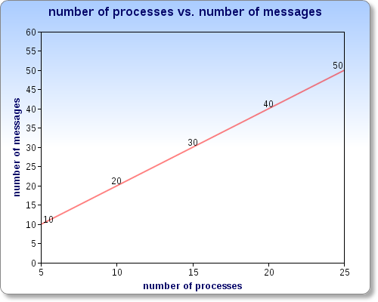
Results

Slide 8
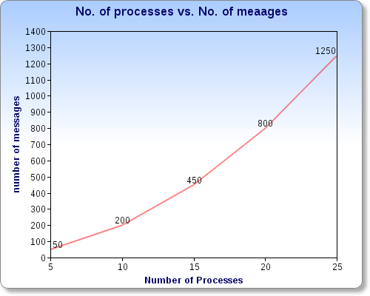
Results(contd.)

Slide 9
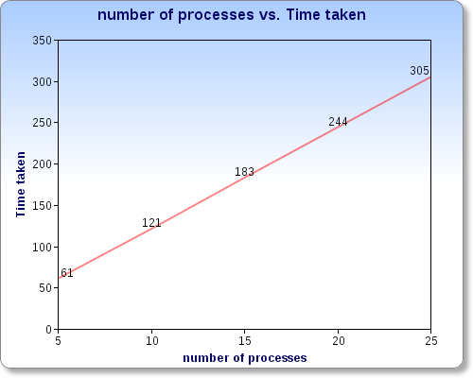
Result(contd.)

Slide 10
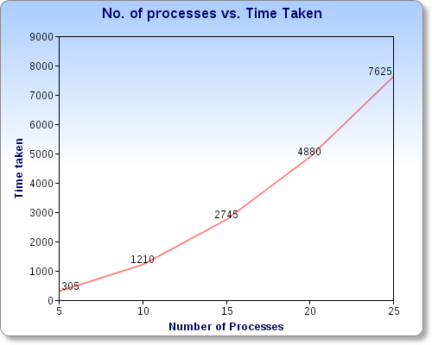
Result(contd.)

Slide 11
Processes | Message complexity |  | Time complexity
 | Single initiator | All initiators | Single initiator | All initiators
5 | 10 | 50 | 61 | 305
10 | 20 | 200 | 121 | 1210
15 | 30 | 450 | 183 | 2745
20 | 40 | 800 | 244 | 4880
25 | 50 | 1250 | 305 | 7625

Slide 12
Conclusion
As the number of processes increase, the number of messages exchanged increase in the same order to detect a deadlock.
But if the number of initiators increase, The number of messages exchanged to detect a deadlock for each of these initiators increase significantly.
Message complexity and time complexity increase significantly with the number of initiators.

Slide 13
Future Work
Implementing the algorithm more efficiently for more number of initiators with random number of processes changing their state from being active to idle.
Random number of initiators initiating the query at any point of time.
The algorithm can be improved to decrease the number of messages exchanged since the same set of messages for single and multiple initiators.

Slide 14
References
K.M. Chandy, J. Mishra and L.M. Haas “Distributed Deadlock Detection”. ACM Transaction on Computer Systems. 1(2)pp 141-156. May 1983.
Code
Thank you.

