Slide 1
Corona Linearization
Patrick O’Donnell

Slide 2
The Algorithm
Timeout: send to both neighbors
Receive: receive a message and if it is closer than current neighbors, update them.
In the end it creates a chain containing every process

Slide 3
The Experiment
Variables:
Ring vs. Star topology
Number of nodes from 5 to 30
Measure:
Number of commands executed
Most messages in all channels at a given time
Messages remaining in the channels at the end

Slide 4
The Assumptions
The number of commands executed would increase exponentially faster than the number of messages
Star will be faster since messages won’t have to propagate as far

Slide 5
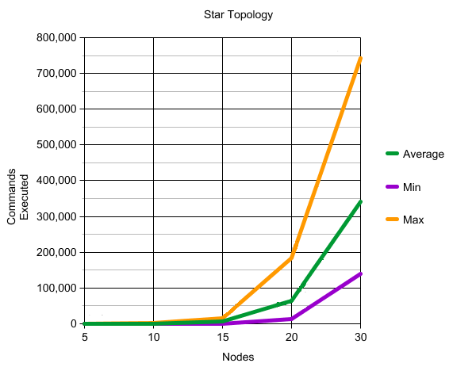
Notice the scale

Slide 6
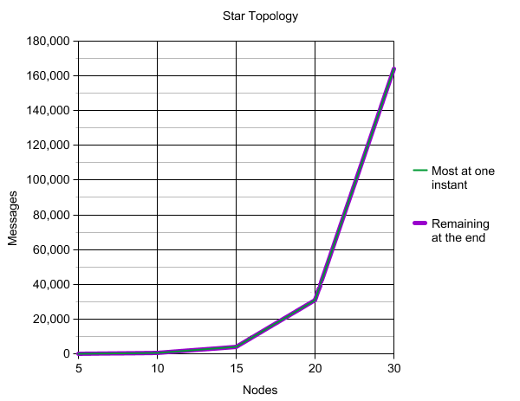
Notice the scale

Slide 7
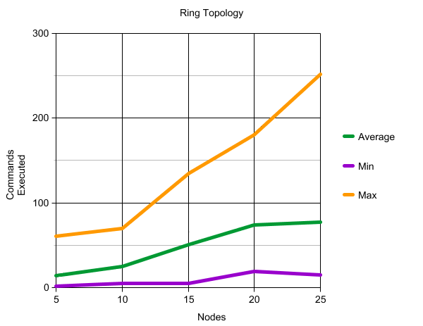
Notice the scale

Slide 8
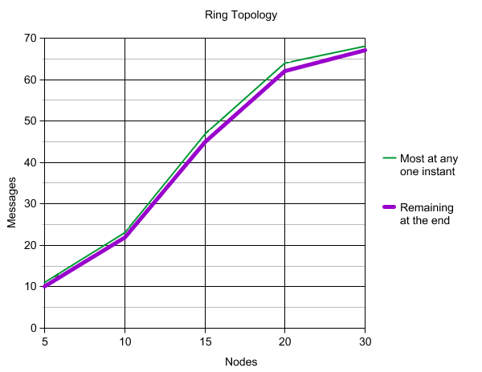
Notice the scale

Slide 9
The Results
Ring is much faster
Lower bound is constant
Average seems linear
Upper bound seems exponential
But lower bound for the star seems exponential
Remaining messages vs. Most messages at any instant is interesting. Messages are sent too loosely.
Any sent message remains in the channels until computation finishes unless it is positive or negative infinity.

Slide 10
Future Research
Test the star with more nodes
See if the ratio of remaining messages to most messages remains the same across different topologies

