Slide 1
Tarry’s & Awerbuch’s Algorithms
by Brian Bartman

Slide 2
Outline
Algorithms
Tarry’s Algorithm
Time and Message complexity
Awerbuch’s Depth First Search Algorithm
Time and Message complexity
Experiment
Description
Experiment Variables
Test Cases
Expected Results
Actual Results

Slide 3
Tarry’s Algorithm
var used_{p}[q] : boolean Init false for each q ∈ Neigh_{p};
father_{p} : process init undef ;
For the initiator only execute once:
begin father_{p}:= p ; choose q ∈ Neigh_{p};
used_{p}[q] := true ; send <tok> to q
end
For each process upon receipt of <tok> from q₀:
begin if father_{p} = undef then father_{p} := q₀ ;
If ∀_{q} ∈ Neigh_{p} : used_{p}[q]
then decide
else if ∃_{q} ∈ Neigh_{p} ( q ≠ Neigh_{p} ∧ ¬used_{p} [q])
then begin choose q ∈ Neigh_{p} \ { father_{p}}
with ¬used_{p} [q];
used_{p}[q] := true ; send <tok> to q
end
else begin used_{p} [father_{p}] := true ;
send <tok> to father_{p}
end
end

Slide 4
Tarry’s Time And Message Complexity
Because Tarry’s algorithm is a traversal algorithm both the time complexity and message complexity are the same.
Time Complexity = Message Complexity
2E

Slide 5
Awerbuchs
var used_{p}[q] : boolean Init false for each q ∈ Neigh_{p};
father_{p} : process init undef ;
For the initiator only, execute once:
begin father_{p} := p; choose q ∈ Neigh_{p};
forall r ∈ Neigh_{p} do send <vis> to r;
forall r ∈ Neigh_{p} do receive <ack> from r;
used_{p}[q] := true ; send <tok> to q
end
For all processes upon receive of <tok> from q₀:
begin if father_{p} = undef then
begin father_{p} := q₀ ;
forall r ∈ Neigh_{p} \ { father_{p} } do send <vis> to r ;
forall r ∈ Neigh_{p} \ { father_{p} } do receive <ack> from r ;
end ;
if ∀_{q} ∈ Neigh_{p} : used_{p}[q] then
if p is the initiator
then decide
else
send <tok> to father_{p}
end
else
choose q ∈ Neigh_{p} with ¬used_{p} [q];
used_{p}[q] := true ; send <tok> to q
end
end
For all processes upon receive of <viz> from q₀:
begin used_{p}[q₀] := true; send <ack> to q₀ ;

Slide 6
Awerbuch’s Time And Message Complexity
Time Complexity
4N - 2
Time Complexity = Message Complexity
4E

Slide 7
Experiment
Description: The goal of the experiment is to measure time and message complexities of Tarry’s and Awerbuch’s algorithms and compare them over various topologies with increasing numbers of nodes. The time complexities measured accounting for both parallel and sequential executions of both algorithms, however this only effects the execution time of Awerbuch’s algorithm. The different topologies tested were: star, chain ring and clique. Each topology was tested with 2 to 25 nodes comprising the topology. Each of the different number of nodes between 2 and 25 was each tested 5 times and the averages taken.

Slide 8
Experiment Variables
Independent Variables
Number of nodes
Dependent Variables
Number of messages sent
Number of guarded commands executed
Parallel time (recorded for Awerbuch’s).

Slide 9
Test Cases
Topologies
Chain
Clique
Ring
Star
For each topology graphs were constructed for 2 to 25 nodes.
Each of the configurations between 2 and 25 were each tested 5 times.

Slide 10
Expected Results
Chain
Tarry’s will out perform Awerbuch’s because Tarry’s time complexity is 2E and the topology of the graph prevents Awerbuch’s from taking advantage of parallel execution of <ack> and <vis> sends and receives.
Clique
Awerbuch’s will have a lower time complexity (linear) in parallel because the number of nodes is what Awerbuch’s depends upon, while Tarry’s depends upon the number of edges which is increasing exponentially.
Star
Awerbuch’s will take longer than Tarry’s algorithm, because it is unable to exploit parallelism.
Ring
Awerbuch’s will take longer to complete because it is still unable to exploit the ability to send messages in parallel.

Slide 11
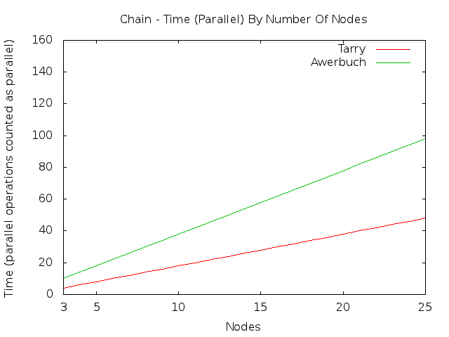
Chain Results

Slide 12
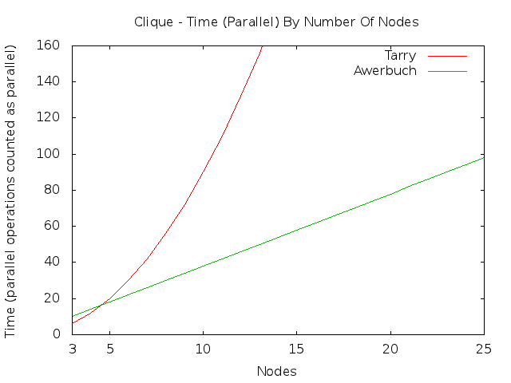
Clique Results

Slide 13
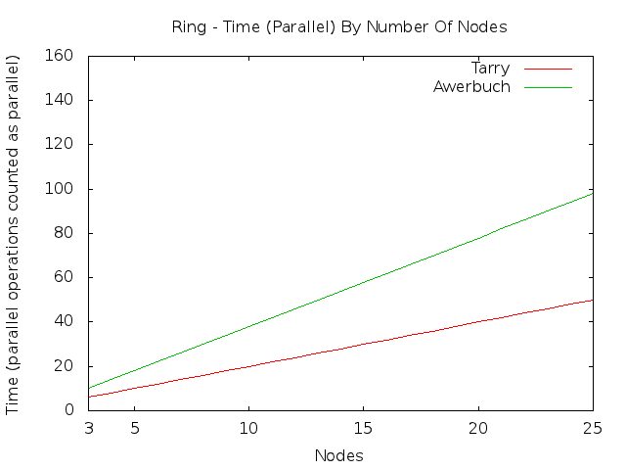
Ring Results

Slide 14
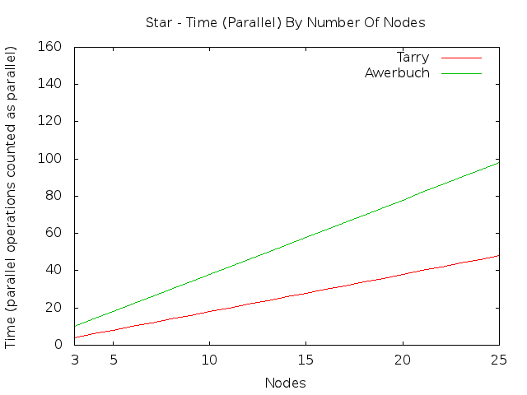
Star Results

Slide 15
Future Work
What I would like to do is to develop an idea of what type of density is necessary for Tarry’s algorithm to be faster than Awerbuch’s on arbitrary topologies, and possibly develop some sort of rating system which could rate the density of a network and see exactly how sparse or dense a network would need to be in order for Awerbuch’s algorithm to be either faster or slower than Tarry’s.

Slide 16
References
A. Baruch, “A New Distributed Depth-First-Search Algorithm,”
Information Processing Letters 20, pp. 147-150, 1985.
G. Tarry, “Le Problem Des Labyrinthes,” Nouvelles Annales de
Mathematique 14, 1895.

