Slide 1



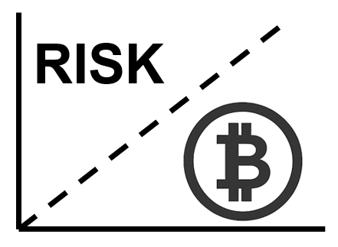
When Can You Trust Bitcoin? Value-Dependent Block Confirmation to Determine Transaction Finality
Ethan Hicks
Joseph Oglio
Gokarna Sharma
Mikhail Nesterenko
Zurich, Switzerland
November 19-21, 2025

Slide 2
General Geoconsensus
Outline
  Consensus and Geoconsensus
  impossibility
  BASIC solution
  GENERIC solution

Slide 3
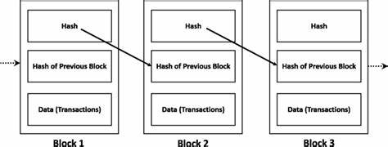
Blockchain
Blockchain:
A decentralized digital ledger that records transactions across network participants called peers.
Bitcoin is a common cryptocurrency blockchain.
It contains a sequence of blocks.
Each block has transaction data, a timestamp, and a cryptographic hash linking it to the previous block.
Clients submit transactions to be recorded by peers.

Slide 4
Consensus
Consensus Mechanism:
Each peer competes to add the next block to the chain by solving a cryptographic puzzle.
This process is called mining which is performed by peers called miners.
A newly mined block is broadcast.
Once the new block is received, the other miners will mine on it if it forms the longest chain.

Slide 5
Forks
Forks:
Blocks may be mined concurrently creating a fork.
When a miner starts mining on a longer branch this is known as a switch.
The branch they switch from becomes dead.
Transaction confirmation/invalidation:
Transactions on the dead branch are invalidated,
Their blocks are considered flipped.
Transactions on the surviving branch are considered confirmed.
Due to network delay or malicious attacks, a client is unsure whether a transaction is confirmed or if it will be invalidated.

Slide 6
Research Problem and Approach
We quantified the probabilistic factors that determine blockchain transaction confirmation success
And developed a risk assessment strategy for estimating potential financial losses from transaction invalidation by applying Prospect Theory

Slide 7


Prospect Theory
Risk Assessment: Quantification of the likelihood of a transaction being invalidated. Calculated experimentally and through the collection of data. Depends on the depth of the transaction in the blockchain
Loss Function: Mathematical representation that captures the perceived negative impact when a transaction is invalidated. Loss aversion coefficient that models the tendency to weigh loses more heavily, λ = 2.25. Diminishing sensitivity to higher losses, β = .88.

Slide 8


Prospect Theory
Loss Threshold Probability: Representation of the user’s transaction revocation risk tolerance. c is used to tune a particular user's aversion to loss. Its value is chosen such that LT (1) = 0.5. Meaning that a user is willing to lose a single dollar 50% of the time
Confirmation Depth: Minimum confirmation depth represents the number of blocks a client should wait after transaction submission to reasonably ensure its permanence on the blockchain, minimizing the risk of invalidation. We determine the minimum confirmation depth based on each transactions monetary value and the likelihood of a transaction being flipped.

Slide 9
Experiment Setup
We implemented the Bitcoin blockchain in QUANTAS simulator
We simulated a network of 100 peers
Examined its operation under 10 different network delays
For each data point, we ran a computation for 1000 rounds
We tracked:
  blockchain length
  the number of switches
  flipped blocks
  flip frequency
Examining Forks: We monitored each peer's longest chain and counted flipped blocks whenever switches occurred.
Actual Bitcoin Data: We examined data from the last 1000 blocks mined and taking mining pools into account determined the probability of a fork under different network delays.

Slide 10
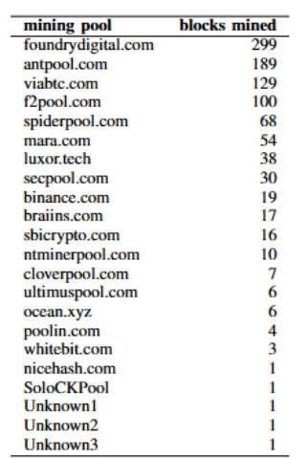
Retrieved Data
Distribution of blocks mined in the most recent 1,000 Bitcoin blocks by pool.

Slide 11
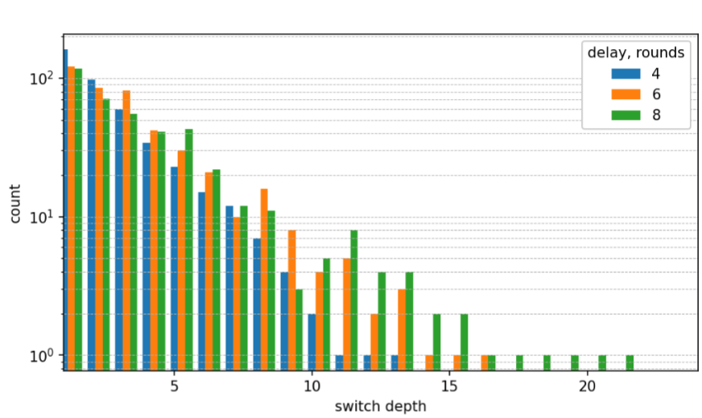
Experimental,
Switches vs. Length
The number of switches and their lengths increase with network delay.
As the network delay increases, so does the probability of a transaction being flipped at higher depths.

Slide 12
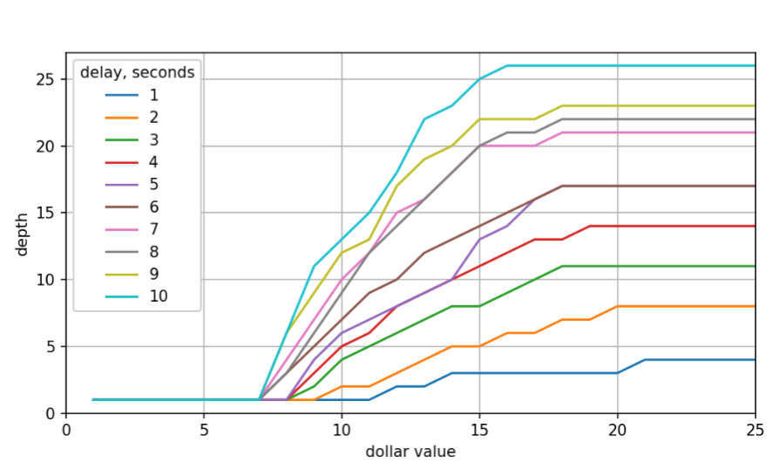
Experimental,
Minimum Confirmation Depth vs. Dollar Value
Minimum confirmation depth requirements increase with both transaction value and network delay.

Slide 13
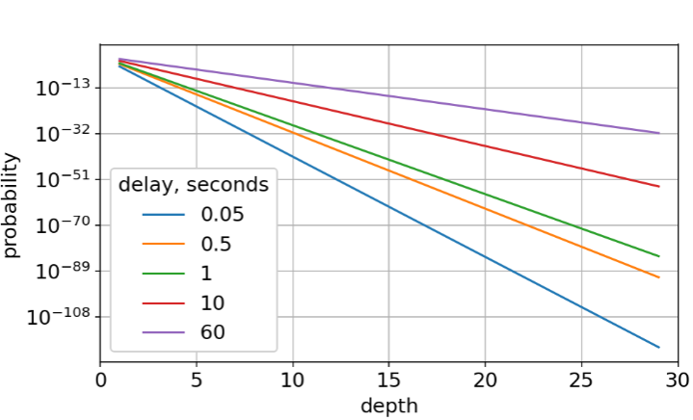
Bitcoin Data,
Probability of Flip vs. Depth
As the block depth increases, its revocation probability declines. This decline is shallower with greater network delay.

Slide 14
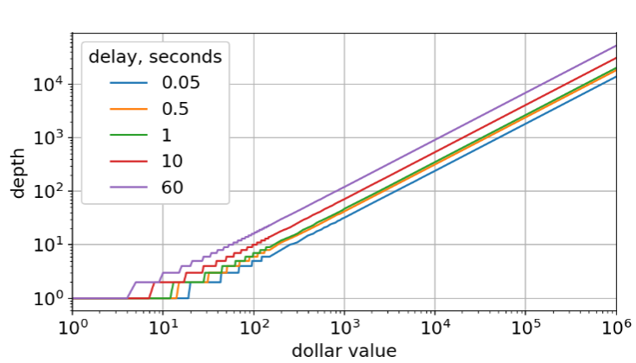
Bitcoin Data,
Probability of Flip vs. Depth
Minimum confirmation depth requirements increase with both transaction value and network delay.

Slide 15
Future Work/Conclusion
Value Dependent Finality: Our research explores the connection between transaction value and the confirmation depth:
Low-value transactions such as small purchases, require minimal block confirmations for acceptable finality, possibly only 1 block.
High-value transactions such as automobile or house sales, necessitate substantially more confirmations due to increased risk exposure.
This value-dependent change aligns with economic theory: users rationally implement stricter security measures as potential loss increases. Our model quantifies the relationship between risk and confirmation time.
Future research could explore practical implementation of this risk-based confirmation framework in commercial applications.

Slide 16
Recap
We
posed Geoconsensus Problem
proved it impossible if covered by less than 4 areas
presented BASIC solution requiring set density of processes
developed GENERIC without density requirement
  provided processes can be covered by individual areas
  showed coverage solution is NP-hard, provided efficient heuristic
  determined coverage requirements for GENERIC for square, circular and 3d areas
Questions?

