Slide 1
Consensus Through Knot Discovery in Asynchronous Dynamic Networks
Rachel Bricker
Mikhail Nesterenko
Gokarna Sharma
Nagoya, Japan
October 22, 2024

Slide 2
Motivation & Contribution
traditionally, distributed ledger technologies are considered always connected or delays are insignificant
may not be the case if large network, long delay, or narrow bandwidth
can consensus be achieved in communication-limited networks?
our contribution
define the Knot Identification Problem
prove necessary and sufficient conditions for the existence of solution to problem
develop algorithm KIA (Knot Identification Algorithm) to solve the problem
implement, simulate, and analyze performance
Notes:
strongly connected: every pair of vertices is mutually reachable

Slide 3
Terms
dynamic network - network whose topology changes over time
directed edges appear/disappear at
any state of computation
knot - strongly connected component with no incoming edge(s) from outside the component
. . .
time t
time t + 1
6
11
a
b
a
b
detects {a,b,c,d}
a
b
detects {a,b,c,d}
3
⇒
8
7
4
10
8
1
9
c
d
c
d
d
detects {b,c,d}
c
d
detects {a,b,c,d}
2
5
detects {a,b,c,d}
9
e
e
e
detects {b,c,d}
e
detects {a,b,c,d}
Notes:
TERMS WHICH COULD BE COVERED HERE: PRIMARY KNOT,
strongly connected: every pair of vertices is mutually reachable

Slide 4
Outline
knot identification: necessary and sufficient conditions
KIA: knot identification algorithm
description
performance evaluation

Slide 5
Consensus Problems vs. Knot Identification
Consensus problems - solution conforms to the three classic properties:
agreement - no two processes decide differently
validity - if all processes input the same value v, then every process decides v
termination - every process eventually decides
Knot identification - solution conforms to the two properties:
agreement - no two processes output different knots
termination - every process eventually outputs a knot
Proposition 1. A knot-identification adversary is also a consensual adversary.
intuitively: once knot identification problem is solved, the consensus value can be input of knot process…
with highest identifier
incident to oldest link
etc.

Slide 6
Global Observability
a knot is globally observable if every process eventually sees it
Proposition 2. In a solution to the Knot Identification Problem, every process outputs only a globally observable knot.
intuitively: to ensure agreement, all processes must eventually observe the output knot
a
b
a
b
c
d
c
d
e
e
{b,c,d} is globally observable
{b,c,d} is not globally observable

Slide 7
Knot Opacity
An adversary 𝒜 is knot opaque if there is a process p and a computation σ₁ ∈ 𝒜 such that for every state s_{i} of σ₁ and every knot K observed by p in states up to s_{i}, there is another computation σ₂ that is local observation graph identical to σ₁ for p up to s_{i}, yet K is not globally observable in σ₂
intuitively: inhibits processes from knowing whether or not a particular knot they observe is globally observable.
Lemma 1. There does not exist a solution to the Knot Identification Problem for a knot opaque adversary.
identical
σ₁
K
σ₂
K
p₁
p₁
s_{i}
knot opaque
s_{i}
K
K
K
p₂
p₂
K
K is globally observable
K is not globally observable
Notes:
AUDIENCE NEEDS TO KNOW: observation graph identical, globally observable
If a process observes a globally observable knot in one computation, then there exists another computation indistinguishable to the process up to the state it outputs the knot such that the knot is not globally observable.

Slide 8
Asynchrony
An adversary 𝒜 is asynchronous if it contains a computation σ₁, then there is a computation σ₂ which is obtained from σ₁ by inserting a non-communicating state after an arbitrary state of σ₁
intuitively: process communication may be delayed for arbitrarily long
σ₁
σ₂
asynchronous
. . .
. . .
. . .
. . .
s_{i}
s_{i+1}
s_{i}
s_{i+1}
s_{i+2}

Slide 9
Knot Finality
An adversary 𝒜 is knot observation final if it contains a computation σ₁ where there is a process p such that, for every state s_{i} of σ₁, there is a computation σ₂ which is observation graph identical to σ₁ for p up to state s_{i} such that, after state s_{i}, it does not contain any more knot observations by p
intuitively: a process’ collection of observed knots may not increase for the rest of the computation… a process may not gain additional knot information by delaying its decision
identical
σ₁
σ₂
K₁
K₂
knot observation final
K₁
p₁
p₁
s_{i}
s_{i}

Slide 10
Knot Finality Continued
Lemma 2. Consider an observation final, asynchronous, knot transparent adversary 𝒜. If 𝒜 contains a computation σ such that a pair of processes observe two different primary knots, then this adversary does not have a knot identification solution even though this adversary is knot transparent.
σ_{i}
K₁
σ_{ij}
K₁
s_{i}
insert non-
communication states repeatedly after s_{i}
s_{i}
p₁
p₁
e₁
K₂
e₁
s_{j}
K₂
K₁
p₂
e₂
p₂
e₂
σ_{ij}
K₁
σ_{ijk}
K₁
s_{i}
insert non-
communication states repeatedly after s_{k}
s_{i}
p₁
p₁
e₁
s_{j}
e₁
s_{j}
K₂
K₂
K₁
s_{k}
K₁
s_{k}
p₂
p₂
e₂
e₂
s_{l}
K₂
Notes:
AUDIENCE NEEDS TO KNOW: knot observation final, primary knot, asynchronous

Slide 11
Knot Identification Problem: Necessary & Sufficient Conditions
Theorem 1. For a knot observation final asynchronous knot transparent adversary 𝒜 to allow a solution to the Knot Identification Problem, it is necessary and sufficient for 𝒜 to be primary uniform.
necessity follows from Lemma 2
sufficiency is proved by algorithm KIA that solves the Knot Identification Problem under 𝒜

Slide 12
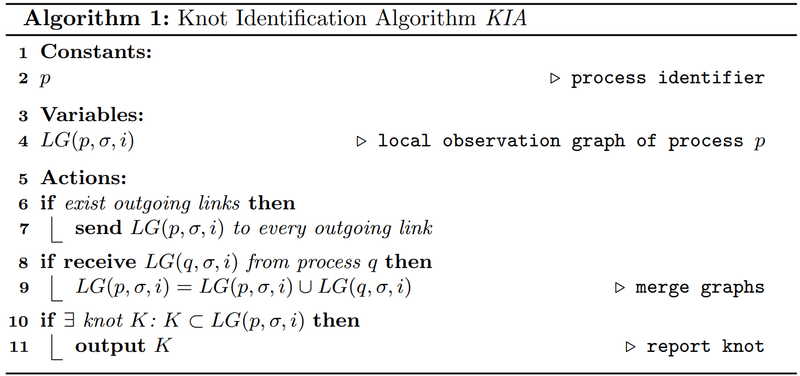
KIA (Knot Identification Algorithm)
each process relays all its observed connectivity data across every outgoing link
combine observed connectivity data with received connectivity data
output detected knots
Notes:
WE HAVEN’T DEFINE LOCAL OBSERVATION GRAPH!

Slide 13
KIA Complexity Estimation
n: number of processes in the network
only count states where information spreads
algorithm operation can be divided into two parts:
knot formation
if the last process that participates in the knot is the first to observe it, then it is the only process that informs the other processes of the knot
knot data propagation
knot with the longest causally related links is a cycle of n edge
knot data propagation part requires n − 1 edges if all processes are informed sequentially
worst case: these 2 parts run consecutively
worst case KIA complexity is 2n − 1, which is in O(n)

Slide 14
Performance Evaluation Setup
used abstract simulator QUANTAS [16]
computation is represented as a sequence of rounds
in each round, each peer:
receives messages
preforms local computation
sends messages
channels are FIFO and reliable
backbone topology: cycle of processes, rest randomly attached to the cycle
in each round a fixed number of backbone edges appear
⇒ single knot, processes eventually learn about it
Knot

Slide 15
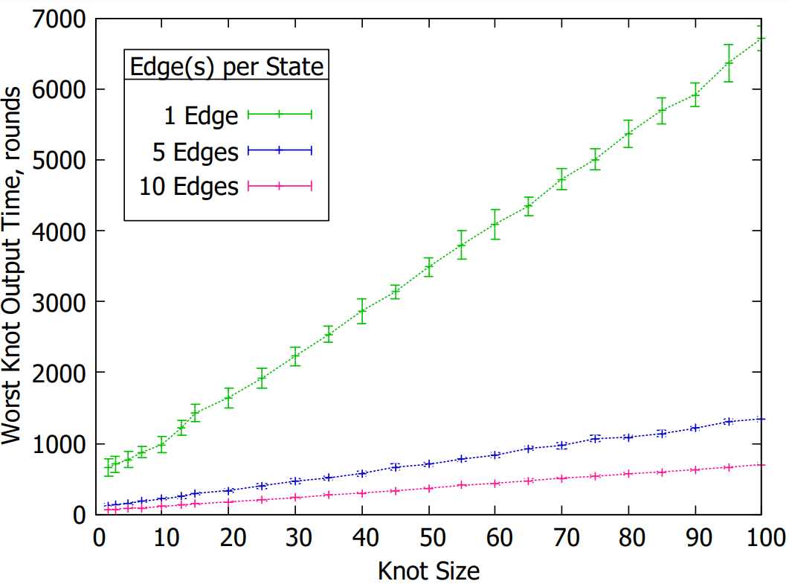
Varying Knot Size
network size: 100 nodes
computation length: 10,500 rounds
computations per data point: 10
varied knot (cycle) size
measured longest knot detection time
larger knot ⇒ longer to detect

Slide 16
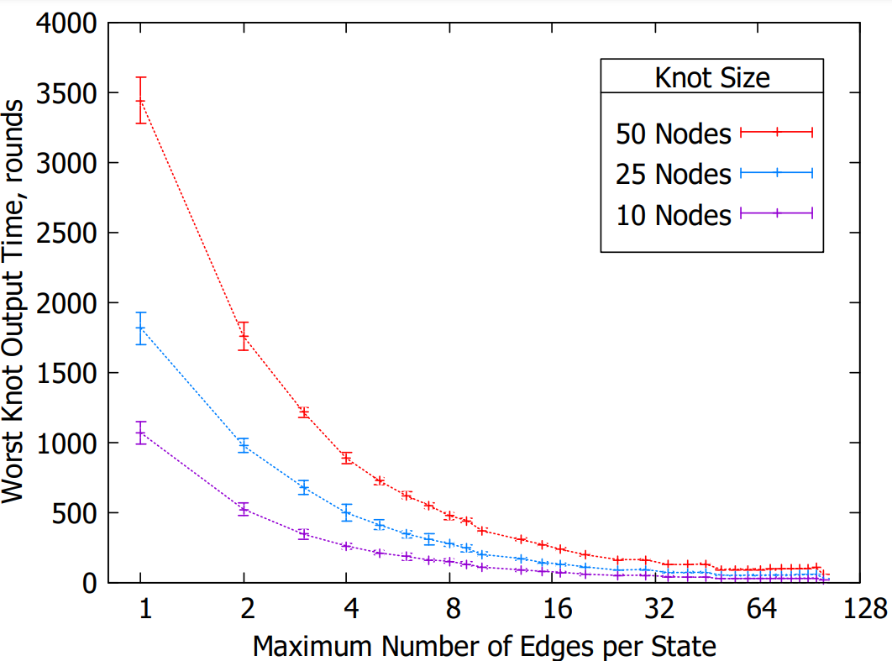
Varying Number of Edges per State
network size: 100 nodes
computation length: 6,000
computations per data point: 10
varied # of edges per state
measured longest knot detection time
fewer edges ⇒ longer detection

Slide 17
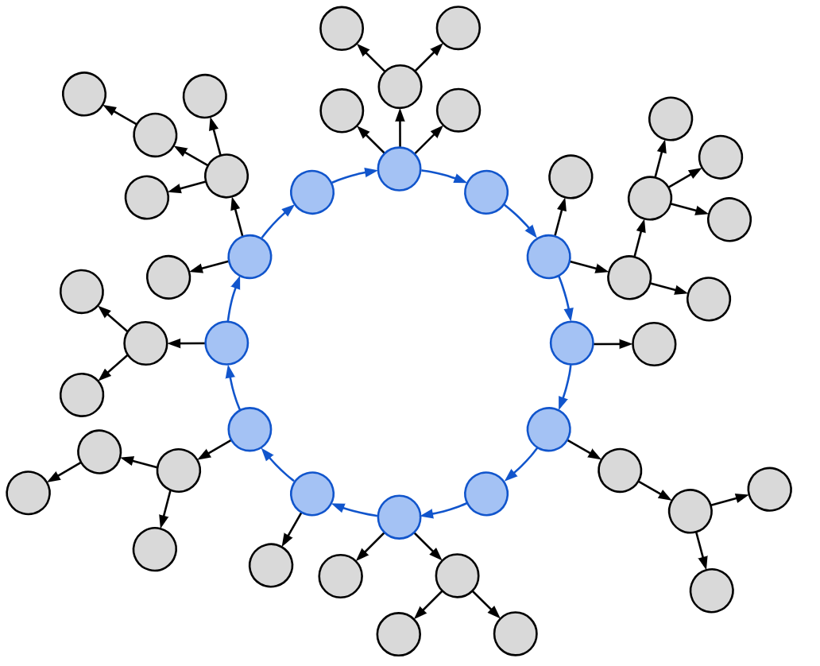
Extensions & Future Work
distinguished knot
program processes to distinguish knots significant to particular system
expiring links
reduce resource usage by discarding links older than some pre-determined period
future work
achieve consensus via other topological features
implement KIA in complete system and evaluate performance in practical settings, e.g. Internet-of-Things networks
Byzantine faults
QUESTIONS?

Slide 18
 | 1 | 2 | 3 | 4 | 5 | 6 | 7 | 8 | 9 | 10 | 11
a
b
c
d
e
a
a
a
a
a
a
a
a
a
a
b
a
b
c
c
c
c
d
c
d
b
b
b
b
b
a
b
a
b
a
b
a
b
a
b
a
b
c
d
c
d
c
d
c
d
c
d
c
d
c
d
c
d
c
d
a
b
a
b
a
b
c
d
c
d
c
d
c
d
c
d
c
d
c
d
c
d
c
d
c
d
c
d
b
b
b
b
a
b
a
b
a
b
a
b
d
d
d
c
d
c
d
c
d
c
d
c
d
c
d
c
d
c
d
b
b
b
b
a
b
a
b
a
b
c
d
c
d
c
d
c
d
c
d
c
d
c
d
c
d
c
d
c
d
e
e
e
e
e
e
e
e
e
e
e

