Slide 1
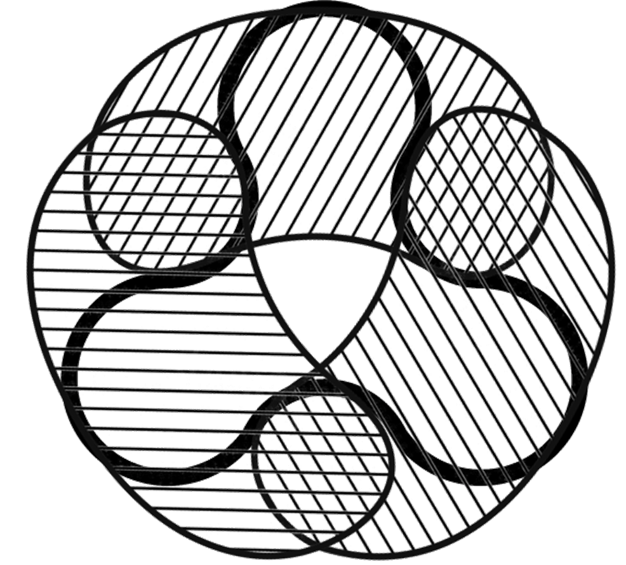
SMARTSHARDS
Churn-Tolerant Continuously Available Distributed Ledger
a
Joseph Oglio
Mikhail Nesterenko
Gokarna Sharma
f
b
e
c
d
Rabat, Morocco
May 22, 2025

Slide 2
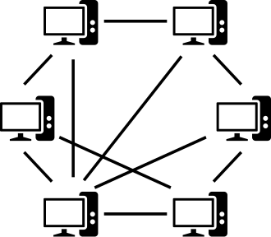
Peer-to-Peer Networks
peer-to-peer (overlay) network – collection of computing entities (peers) joined to perform a task
a peer connects to another peer by learning its identity, message transmission is performed by underlay network: topology may change with computation
decentralized, no single point of failure, peers may join and leave
multiple applications: content delivery, file sharing, data storage, distributed computation, communication
blockchain – distributed ledger of linked transactions/blocks maintained by a peer-to-peer network
able to securely record transactions without central authority
security is ensured by majority of honest peers
peers agree on which blocks to add to blockchain
cryptocurrency blockchain – ledger contains financial transactions

Slide 3
Shards, Faults, Churn
shard – group of peers, sharding – separating network into shards working in parallel
improves network scalability
more shards - greater parallelism
Byzantine fault – arbitrary peer failure or malicious behavior
f - number of faulty peers
(classic) binary Byzantine tolerant consensus [Lamport82] - all
peers need to agree on a value 0 or 1 despite f faults
churn – the joining and leaving of peers
not malicious
need to protect the integrity of the network

Slide 4
Transactions
internal transaction
a transaction which moves currency between wallets in the same shard
cross-shard transaction
a transaction which moves currency from a wallet in one shard to a different wallet in a different shard
typically handled by breaking the transaction into two:
1. moves currency into the other shard
2. moves currency to target wallet in the same shard

Slide 5
Currency Transmission
Distributed Ledger Problem Definition
validity – every confirmed transaction is valid
agreement – if a transaction is confirmed by one correct peer in a shard, it is confirmed by every correct peer in the shard
liveness – if a client submits a valid transaction, it is eventually either conf irmed or invalidated
this problem is solvable with traditional techniques such as Practical Byzantine Fault Tolerance (PBFT), RapidChain, Hyperledger Fabric, etc
however, these schemes are not scalable or introduce unnecessary overhead such as centralized ordering services or synchrony.
can we do better?

Slide 6
Outline
a
SMART-SHARDS algorithm
correctness
simulation and evaluation
extensions
f
b
e
c
d

Slide 7
Practical Byzantine Fault Tolerance (PBFT)
classic consensus algorithm
leader ‒ serializes transactions, starts consensus
replicas ‒ validate transactions
normal operation
4 phases
pre-prepare ‒ leader proposes the transaction to the replicas
prepare ‒ replicas broadcast what they heard to confirm transaction
commit ‒ received 2f + 1 prepares, confirm transaction
reply ‒ inform client of committed transaction
leader change - if client or peers suspect leader is faulty, replace it, transaction confirmation is not affected
client
pre-
prepare
phases:
prepare
commit
reply
p4
p3
peers:
p2
p1

Slide 8
SmartShards: Motivation
cross-shard communication
verifying cross-shard transactions is expensive: need to verify if the first transaction is confirmed before executing the second
previously done using centralization, locking, signatures, or total shard-to-shard broadcasts ⇒ overhead
a
b
f
c
e
d
g
j
h
i
l
k
proposed solution
overlap shards so that cross shard transaction verification can be done by peers in the intersection
a
f
b
e
c
d

Slide 9
SmartShards Algorithm Outline
internal transaction handling
follow standard consensus mechanisms
overlapping design does not interfere, maintaining efficiency
cross-shard transaction handling
peers belongs to multiple shards, creating overlaps
overlapping peers
facilitate direct communication between shards
during cross-shard transactions they relay data without requiring external coordination or full shard-to-shard broadcasts
the target shard performs consensus after receiving sufficient transaction data from overlapping peers to confirm the transaction
a
f
b
e
c
d
Notes:
since all necessary data remains within the shard, no additional coordination is needed

Slide 10
Outline
a
SMART-SHARDS algorithm
correctness
simulation and evaluation
extensions
f
b
e
c
d

Slide 11
SmartShards Correctness
Theorem 1. Algorithm SmartShards solves the Distributed Ledger Problem with at most f Byzantine faults in each shard and at most ⌊x/2 − 1⌋ faults in the overlap between shards.
intuition
internal transactions are handled by the consensus algorithm
cross-shard transactions are verified first by the source shard consensus algorithm, then by the ⌊x/2 + 1⌋ non-faulty peers in the overlap, and again by the peers in the target shard through another final consensus

Slide 12
Handling Churn
churn – continuous joining and leaving of peers
disrupt shards and make verification of cross-shard transactions impossible
high churn can lead to frequent reconfiguration, causing downtime
maintaining shard membership and inter-shard links separately increases complexity
SmartShards solution
overlapping shards inherently maintain both membership and cross-shard links
peers naturally propagate updates as cross-shard transactions, reducing the need for explicit reconfiguration events
churn-resistant design ensures continuous availability and fault tolerance without excessive overhead
requires a Shard Membership Service (SMS) for peers joining the network

Slide 13
Shard Membership Service
SMS – a trusted service that provides up-to-date shard membership information to clients and churning peers
why SMS is needed
helps clients determine which peers are responsible for confirming their transactions
assists new peers in joining the correct system
Byzantine peers may fool them into joining nonexistent shards
shard membership is fluid so confirmation may be difficult to verify
how SMS Works
clients submit transactions to SMS
SMS provides a set of peers in the relevant shard and forwards the transaction to the shard
clients collect confirmations from shard members to ensure transaction validity despite churn
churn resistance
even with continuous churn, SMS ensures clients always communicate with active shard members ensuring availability and correctness

Slide 14
SmartShards Correctness
Theorem 2. Algorithm SmartShards with weak SMS solves the Distributed Ledger Problem with at most f Byzantine faults in each shard and at most ⌊x/2 − 1⌋ faults in the overlap between shards despite peer churn.
intuition
SMS supplies clients and peers fault free access to the correct network preventing Byzantine peers from gaining any influence
churn is treated as a transaction ⇒ membership is maintained by the correctness of the algorithm

Slide 15
Outline
a
SMART-SHARDS algorithm
correctness
simulation and evaluation
extensions
f
b
e
c
d

Slide 16
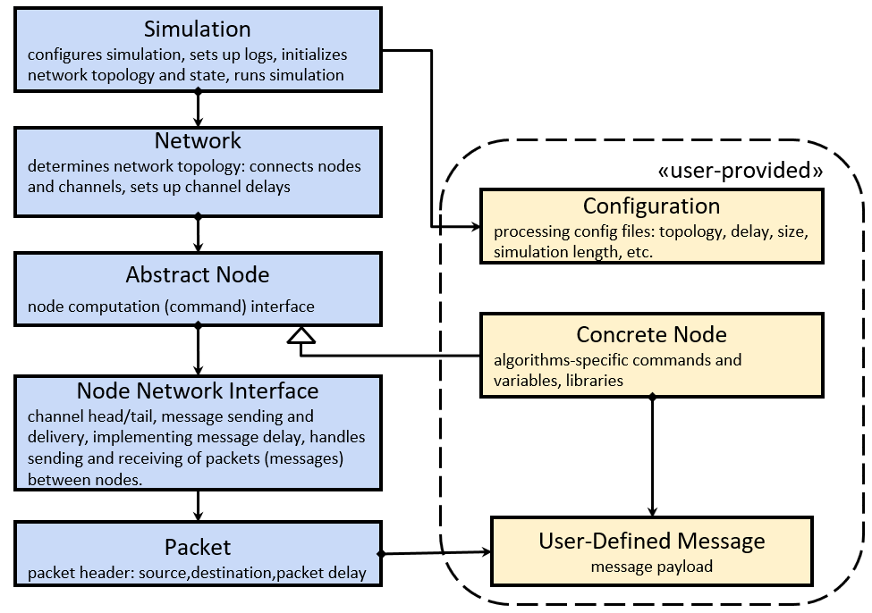
Simulation and Experiments
used abstract simulator QUANTAS
computation is represented as a sequence of rounds
in each round, each peer:
receives messages
preforms local computation
transmit messages
channels are FIFO and reliable
peers are running PBFT as their consensus algorithm
transactions are proposed by the leader with a 1 / S chance of
being an internal transaction
unless otherwise stated 10 tests per data point
500 round computation
each peer is in at most 2 shards

Slide 17
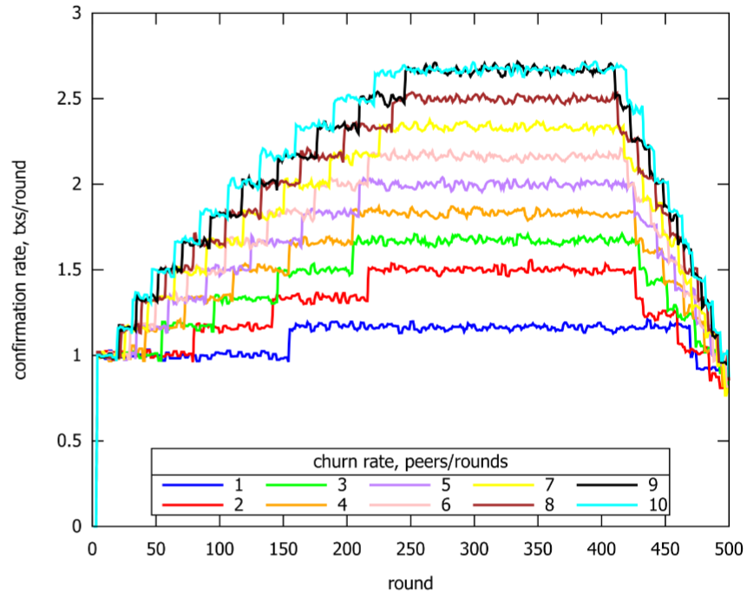
SmartShards with Churn
initially 100 peers, 5 shards, and 10 overlaps
rounds 1-250 peers request to join, 251-500 they request to leave
if the average overlap is >= 25 a new shard is formed, if < 9 a shard is destroyed
3 round rolling average of confirmation rate
100 tests per data point
SmartShards performance scales well as network size increases
the algorithm efficiently manages extensive churn

Slide 18
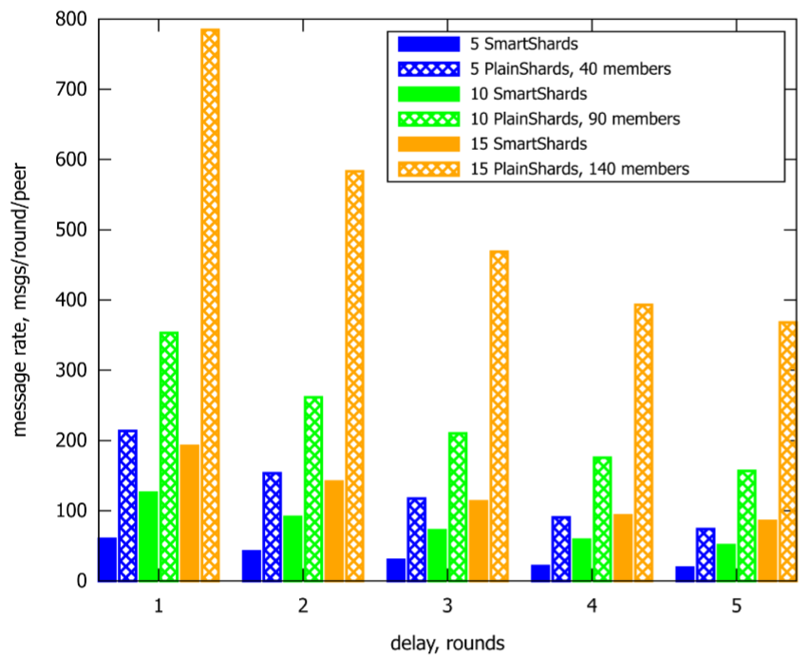
SmartShards vs PlainShards
PlainShards have no overlap: have to do full shard-to-shard broadcast
the overlap count in SmartShards is 10
SmartShards is significantly more efficient no matter the size or delay of the network

Slide 19
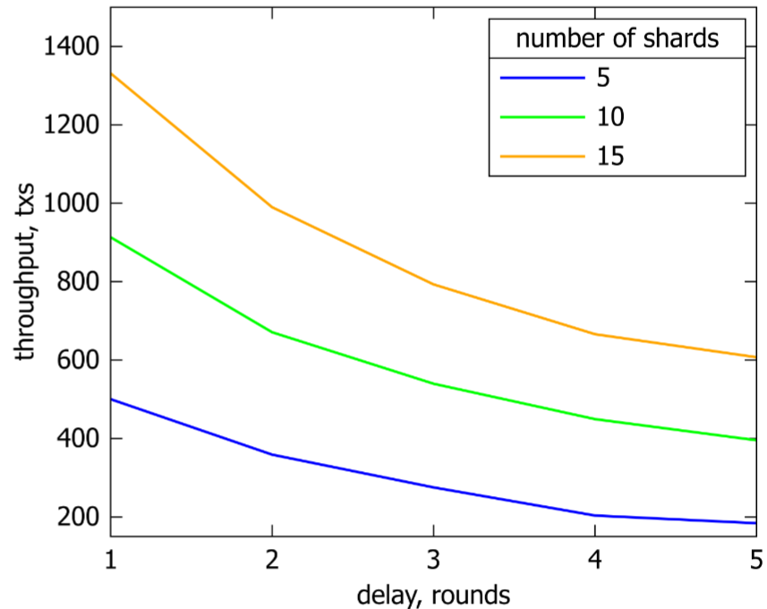
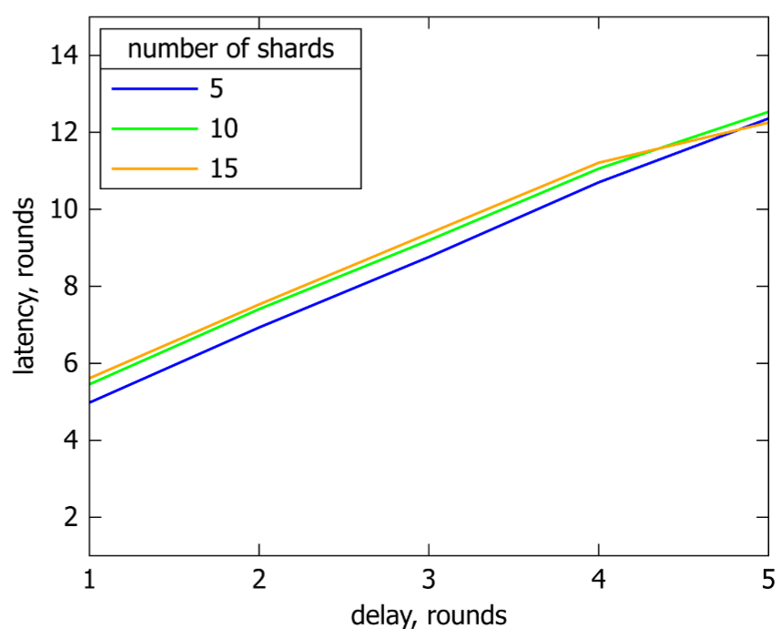
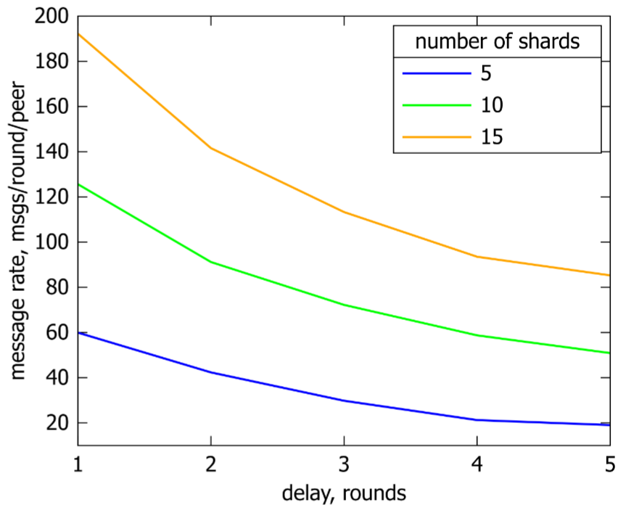
Effect of Shard Count
initially 10 overlaps between shards
each round 1 peer requests to join and 1 requests to leave
as the the number of shards increases the performance of SmartShards improves with a relatively modest increase in message expense

Slide 20
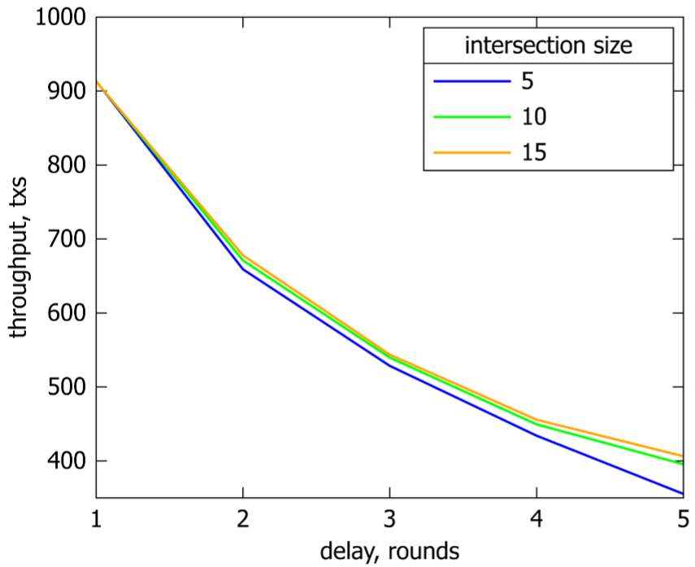
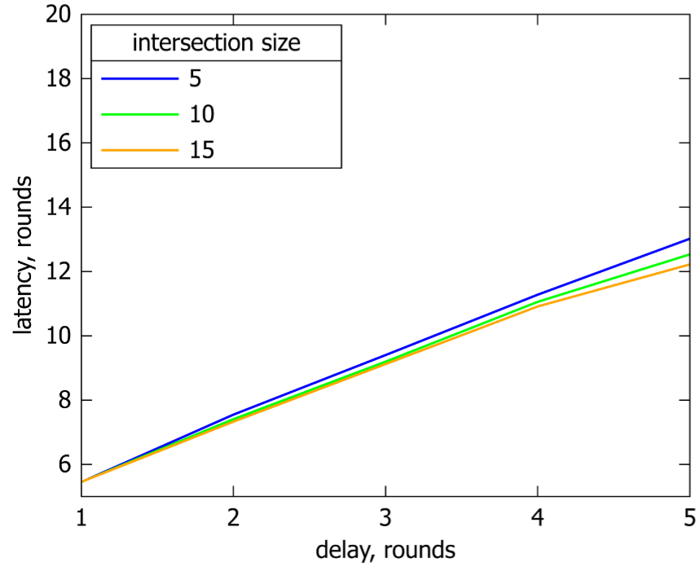
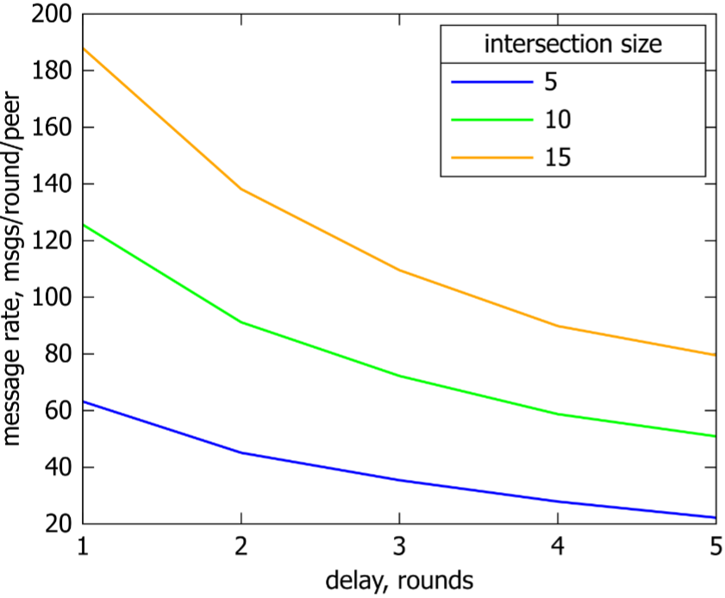
Effect of Overlap
initially 10 shards
each round 1 peer requests to join and 1 requests to leave
the throughput and latency remain relatively unaffected
as the number of intersections increases the message rate increases due to the increase in shard sizes
this cost is relatively low due to the benefit of increasing the Byzantine tolerance threshold of the algorithm

Slide 21
Outline
a
SMART-SHARDS algorithm
correctness
simulation and evaluation
extensions
f
b
e
c
d

Slide 22
SmartShards extensions
blocked transactions: transactions involving the same shards may be grouped into blocks and confirmed together to increase throughput
parallel transaction handling: shards may run multiple non-conflicting transaction blocks simultaneously
wallet optimization: wallets which transact often are moved to the same shard
shard maintenance: efficient methods to split and merge shards to maintain the overlap between them
slowly adaptive adversary: an adversary which may slowly corrupt peers; it is thwarted by a limit on the amount of time a peer may remain in the shard before being forced to move
leave/join attack: attacking peers join and leave in an attempt to overwhelm a shard; is prevented by having a peer in the specified area move to another everytime a new peer enters
consensus algorithm adaptability and enhancement: SmartShards is not dependent on PBFT specifics ⇒ can be replaced by a different consensus algorithm
SMS implementation: side-chain of membership records, a boot-strap service, or a Byzantine-robust host that reliably answers client membership queries

Slide 23
SmartShards: Summary
we
posed the Distributed Ledger Problem
presented SmartShards: a solution to the Distributed Ledger Problem
presented an abstract simulation of the SmartShards algorithm
described additional extensions to SmartShards
Questions?
a
f
b
e
c
d

