Slide 1



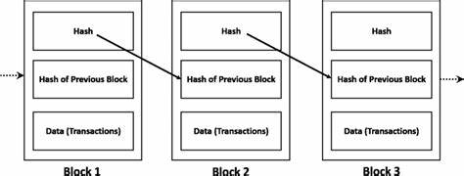
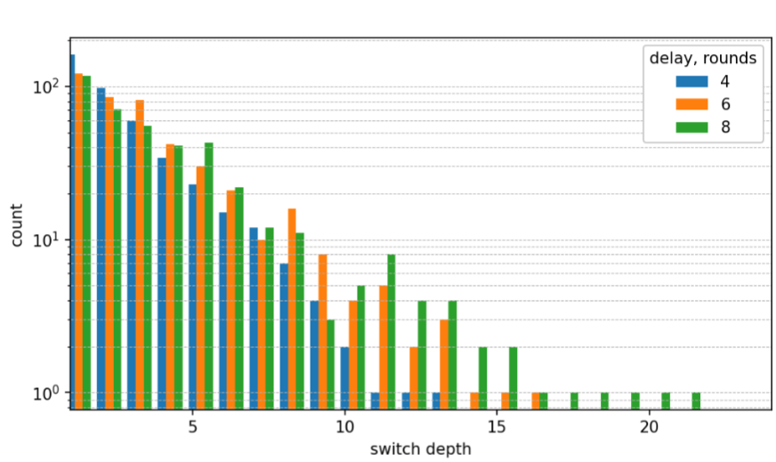
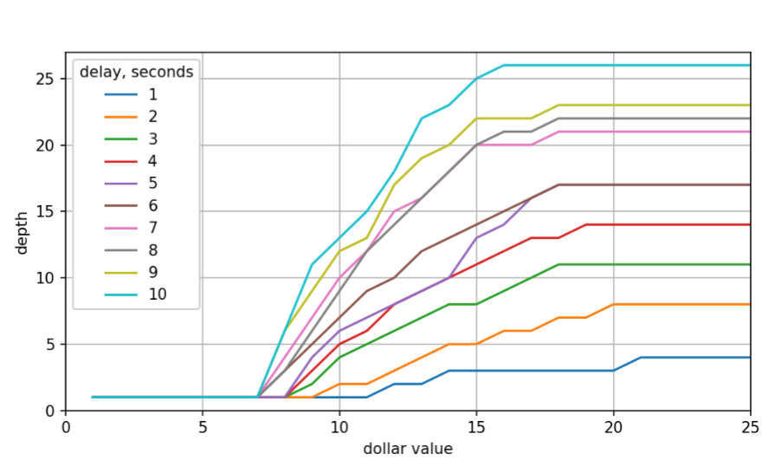
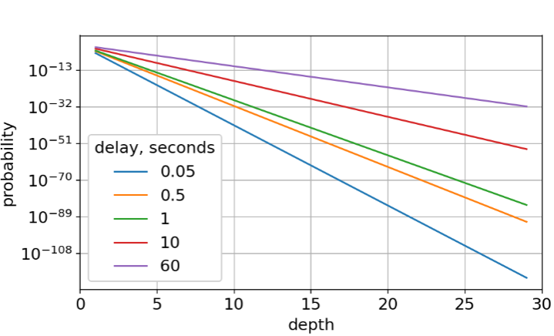
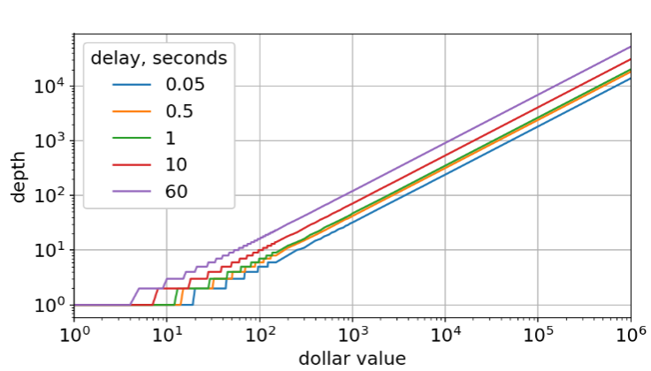




When Can You Trust Bitcoin? Value-Dependent Block Confirmation to Determine Transaction Finality
Presenter: Joseph Oglio Authors: Ethan Hicks, Joseph Oglio, Mikhail Nesterenko, and Gokarna Sharma
Introduction
Results
1
number of switches by length
2
minimum confirmation depth vs. dollar value
Blockchain: A decentralized digital ledger that records transactions across network participants called peers. Bitcoin [1] is a common cryptocurrency blockchain. It contains a sequence of blocks. Each block has transaction data, a timestamp, and a cryptographic hash linking it to the previous block. Clients submit transactions to be recorded by peers.
Consensus Mechanism: Each peer competes to add the next block to the chain by solving a cryptographic puzzle. This process is called mining. A newly mined block is broadcast. Once the new block is received, the other miners will mine on it if it forms the longest chain.
Forks: Blocks may be mined concurrently creating a fork. When a miner starts mining on a longer branch this is known as a switch. The branch they switch from becomes dead.
Transaction confirmation/invalidation: Transactions on the dead branch are invalidated, their blocks are flipped. Transactions on the surviving branch are considered confirmed. Due to network delay or malicious attacks, a client is unsure whether a transaction is confirmed or if it will be invalidated.
3
bitcoin data, probability of flip vs. depth
4
bitcoin data, minimum confirmation depth vs. dollar value
Research Problem and Approach
We quantified the probabilistic factors that determine blockchain transaction confirmation success and developed a risk assessment strategy for estimating potential financial losses from transaction invalidation.
Applying Prospect Theory: We used Prospect Theory [2] to develop practical transaction confirmation thresholds by modeling:
Risk Assessment: Quantification of the likelihood of a transaction being invalidated. Calculated experimentally and through the collection of data. Depends on the depth of the transaction in the blockchain
Loss Function: Mathematical representation that captures the perceived negative impact when a transaction is invalidated. Loss aversion coefficient that models the tendency to weigh loses more heavily, λ = 2.25. Diminishing sensitivity to higher losses, β = .88.
Loss Threshold Probability: Representation of the user’s transaction revocation risk tolerance. c is used to tune a particular user's aversion to loss. Its value is chosen such that LT (1) = 0.5. Meaning that a user is willing to lose a single dollar 50% of the time
Confirmation Depth: Minimum confirmation depth represents the number of blocks a client should wait after transaction submission to reasonably ensure its permanence on the blockchain, minimizing the risk of invalidation. We determine the minimum confirmation depth based on each transactions monetary value and the likelihood of a transaction being flipped.
Experiment Setup
Future Work / Conclusion
Setup: We implemented the Bitcoin blockchain in QUANTAS simulator [3]. We simulated a network of 100 peers and examined its operation under 10 different network delays. For each data point, we ran a computation for 1000 rounds. We tracked blockchain length, the number of switches, flipped blocks, and flip frequency.
Examining Forks: We monitored peers longest chain and counted flipped blocks whenever switches occurred.
Actual Bitcoin Data: We examined data from the last 1000 blocks mined and taking mining pools into account determined the probability of a fork under different network delays.
Value Dependent Finality: Our research explores the connection between transaction value and the confirmation depth:
Low-value transactions such as small purchases, require minimal block confirmations for acceptable finality, possibly only 1 block.
High-value transactions such as automobile or house sales, necessitate substantially more confirmations due to increased risk exposure.
This value-dependent change aligns with economic theory: users rationally implement stricter security measures as potential loss increases. Our model quantifies the relationship between risk and confirmation time.
Future research could explore practical implementation of this risk-based confirmation framework in commercial applications.
Experiment Results & Analysis
(refer to above graph numbers)
number of switches by length: The number of switches and their lengths increase with network delay. As the network delay increases, so does the probability of a transaction being flipped at higher depths.
minimum confirmation depth vs. dollar value: Minimum confirmation depth requirements increase with both transaction value and network delay.
bitcoin data, probability of flip vs. depth: As the block depth increases, its revocation probability declines. This decline is shallower with greater network delay.
bitcoin data, minimum confirmation depth vs. dollar value: Minimum confirmation depth requirements increase with both transaction value and network delay, similar to figure 2.
References
[1] S. Nakamoto. 2008. Bitcoin: “A Peer-to-Peer Electronic Cash System.” https://bitcoin.org/bitcoin.pdf
[2] Kahneman, D. and Tversky, A. (1979) “Prospect theory: An analysis of decision under risk”, Econometrica, 47(2), p. 263. doi:10.2307/1914185.
[3] Oglio, J. et al. (2022) “QUANTAS: Quantitative user-friendly adaptable networked things abstract simulator”, Proceedings of the 2022 Workshop on Advanced tools, programming languages, and Platforms for Implementing and Evaluating algorithms for Distributed systems, pp. 40–46. doi:10.1145/3524053.3542744.
Hello

